Slide 1

Asian American College Access

Slide 2
Overview
Research Question
Literature Review
Framework
Methodology and Data
Analysis
Findings and Conclusions
Implications

Slide 3
Research Question
What are the different experiences of Asian American ethnic groups across Philadelphia and their access to higher education utilizing K-clustering and Moran’s I

Slide 4
Literature Review
Asian American Geography
Liu's (2018) ethnography highlighted highlights the differences in Asian American perspectives, they built a framework that includes three parts.
discourse on Xi Jinping's "Chinese Dream," which emphasizes class advancement
ethnic empowerment through market liberalization
expansion of, specifically, Chinese capital.
Asian Americans in the San Gabriel Valley which fundamentally reshaped the ethnoburb (Cheng, 2013)
In Chan’s (2017), study on geographic differences in being Asian American the theme of race as a social identity was broken updivided into four subthemes:
distancing racial identity,
the strategic use of racial identity,
shifting experiences of race and racial identity to describe the importance of students' hometowns and high schools
how they now felt about their racial context.

Slide 5
Asian American Categorization
(Nadal, 2019) Historic representations of Asian Americans
East Asian – Chinese, Japanese, Korean
South Asian – Pakistani, Bangladeshi, Sri Lankan, Nepalese, Indian
Southeast Asian – Vietnamese, Cambodian, Lao, and Hmong (Mid-1970s)
Filipino - Filipino

Slide 6
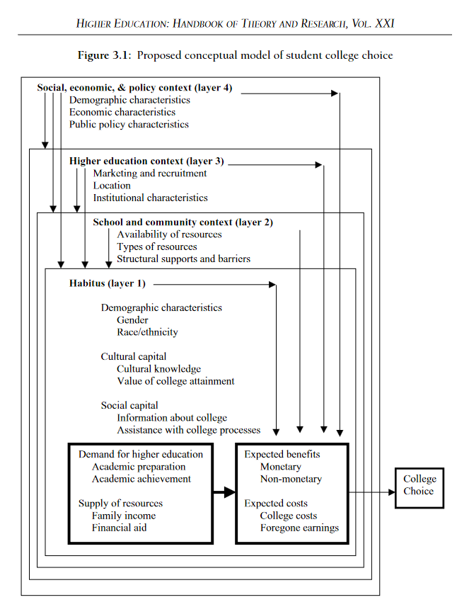
College Access Frameworks
Perna (2006) offers a conceptual model of higher education which encompasses four layers:
habitus,
school and community context,
higher education context,
social, economic and policy context.

Slide 7
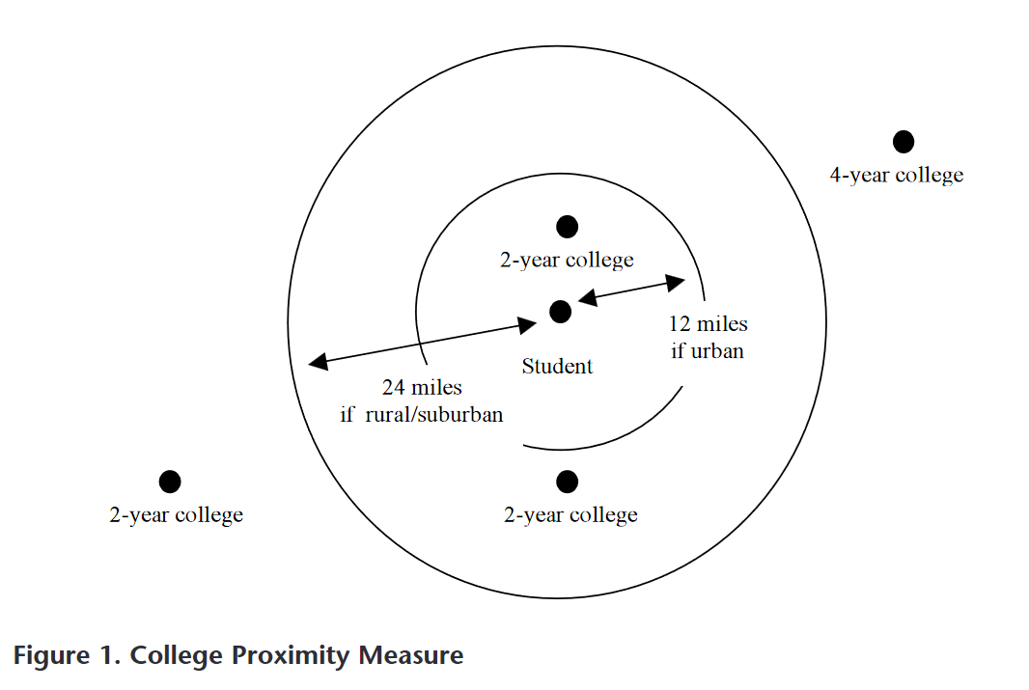
Turley
Turley argues that college choice must be situated in the geographic context and found that high school seniors had a wide range of colleges within commuting distance, zip code had a small but significant increase in the odds of applying to college.

Slide 8
Framework: Critical Geographic College Access (Dache, 2021)
Spatial relationship between municipality and colleges using
History
Racial segregation
Education and economic data
Focuses on physical access
Public Transit
Distance
Proximity of colleges to residents of color

Slide 9
Data
ACS Data
Safegraph Point Data
IPEDS University Data
Home Owner Loan Corporation data

Slide 10
List of Methods
Moran’s I
Local Indicator of Spatial Association (LISA)
Moran’s I has been widely used to test for spatial autocorrelation or spatial dependencies and its value determines the strength of autocorrelation indicating how clustered values are.
Values that are closer to 1 indicate strong positive autocorrelation, while values closer to -1 indicate negative autocorrelation that being how repelled values are. Conversely, if values are positively autocorrelated they are spatially clustered. If the value is close to 0, then there is no spatial autocorrelation, indicating a random pattern.
the LISA for each observation gives an indication of the extent of significant spatial clustering of similar values around that observation and
the sum of LISAs for all observations is proportional to a global indicator of spatial association.The LISA we will be looking at is Moran’s I at a local level for each point. In our case each census block calculated individually and then summed to provide the I in the Moran's I.

Slide 11

Analysis

Slide 12
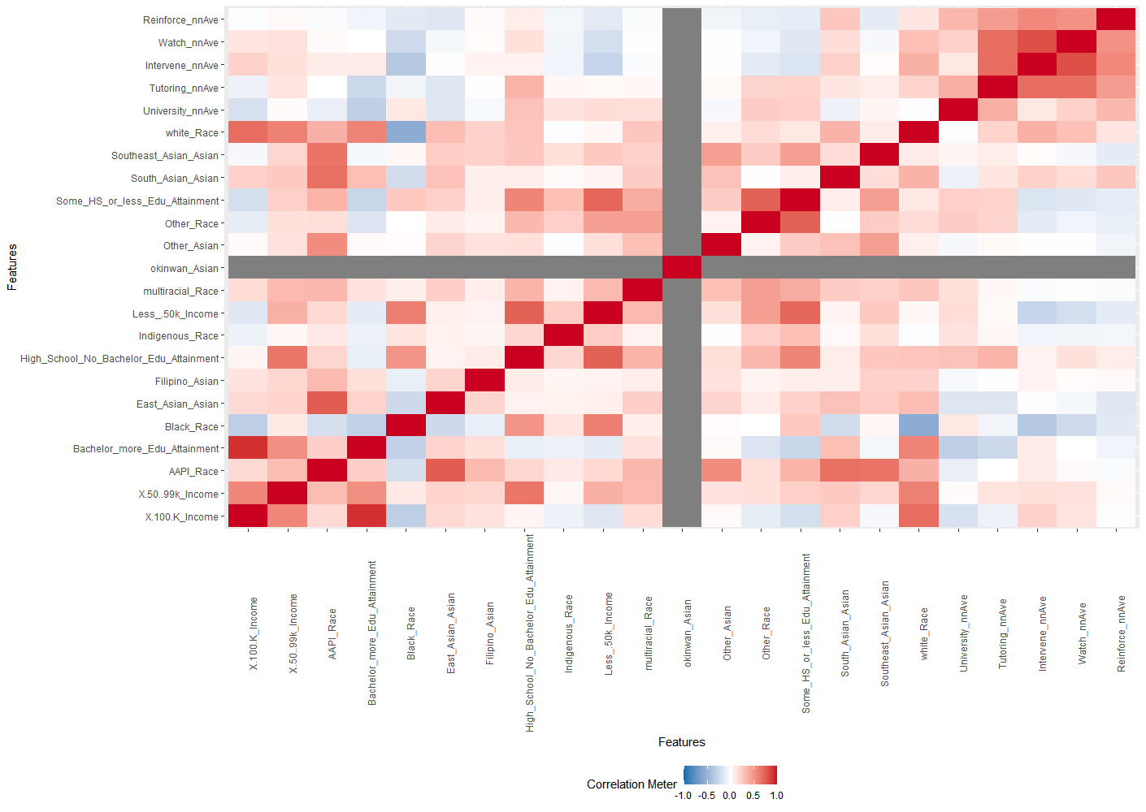
Correlation Table

Slide 13
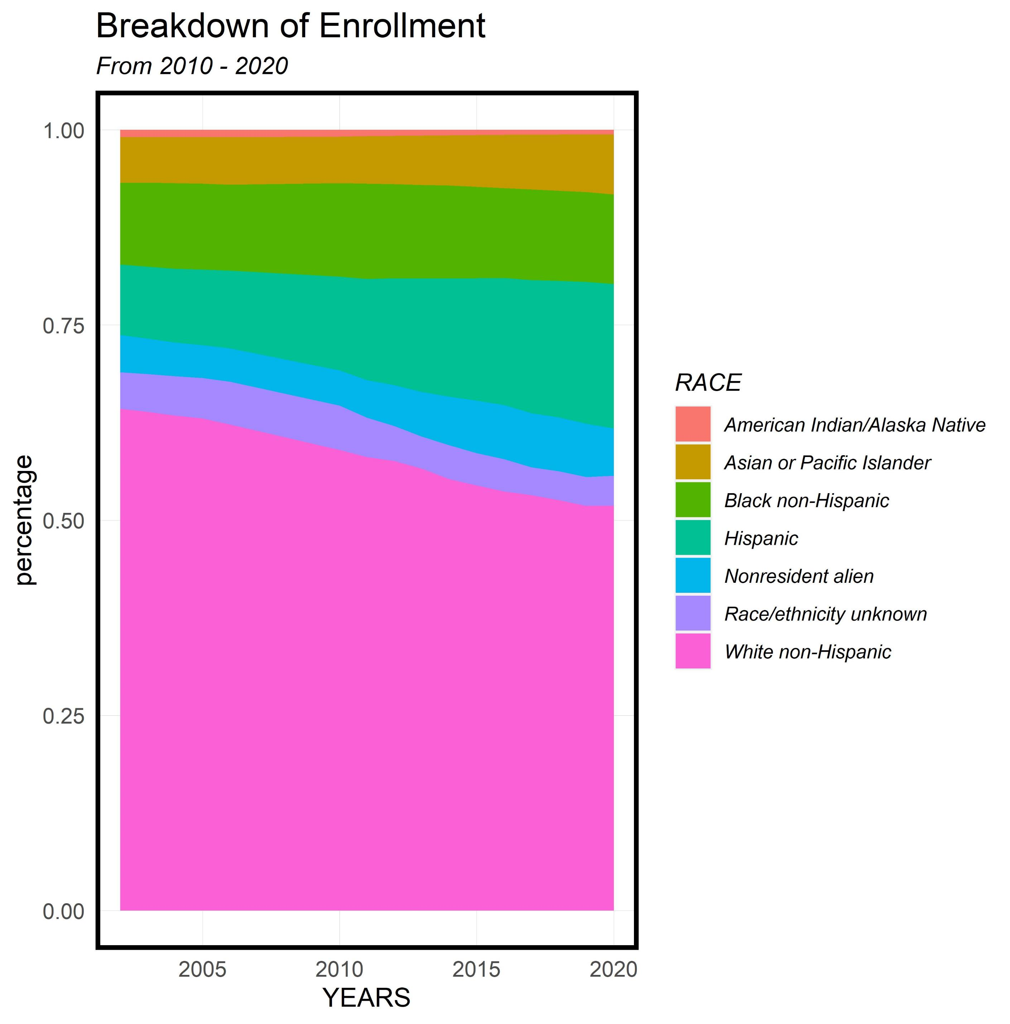
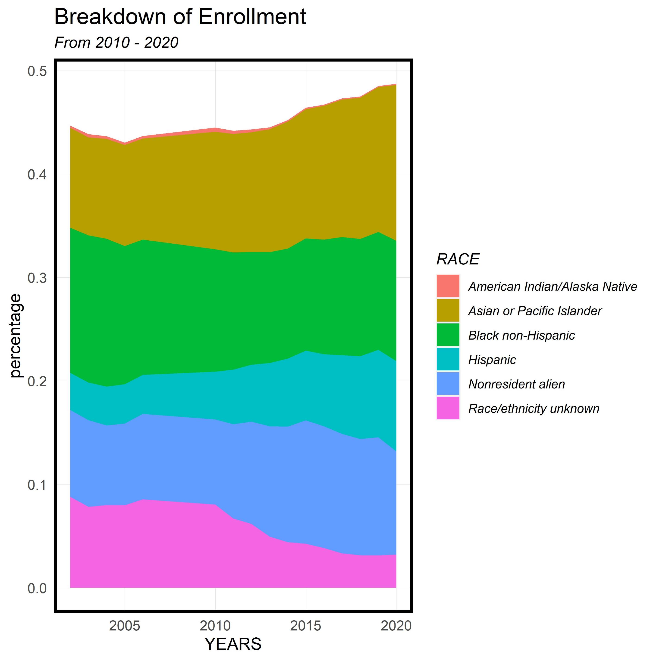
IPEDS Enrollment History
Enrollment over time by Racial groups
Asian Americans have had an increase in enrollment since 2005
It is not clear which Asian Americans have had increased enrollment though

Slide 14
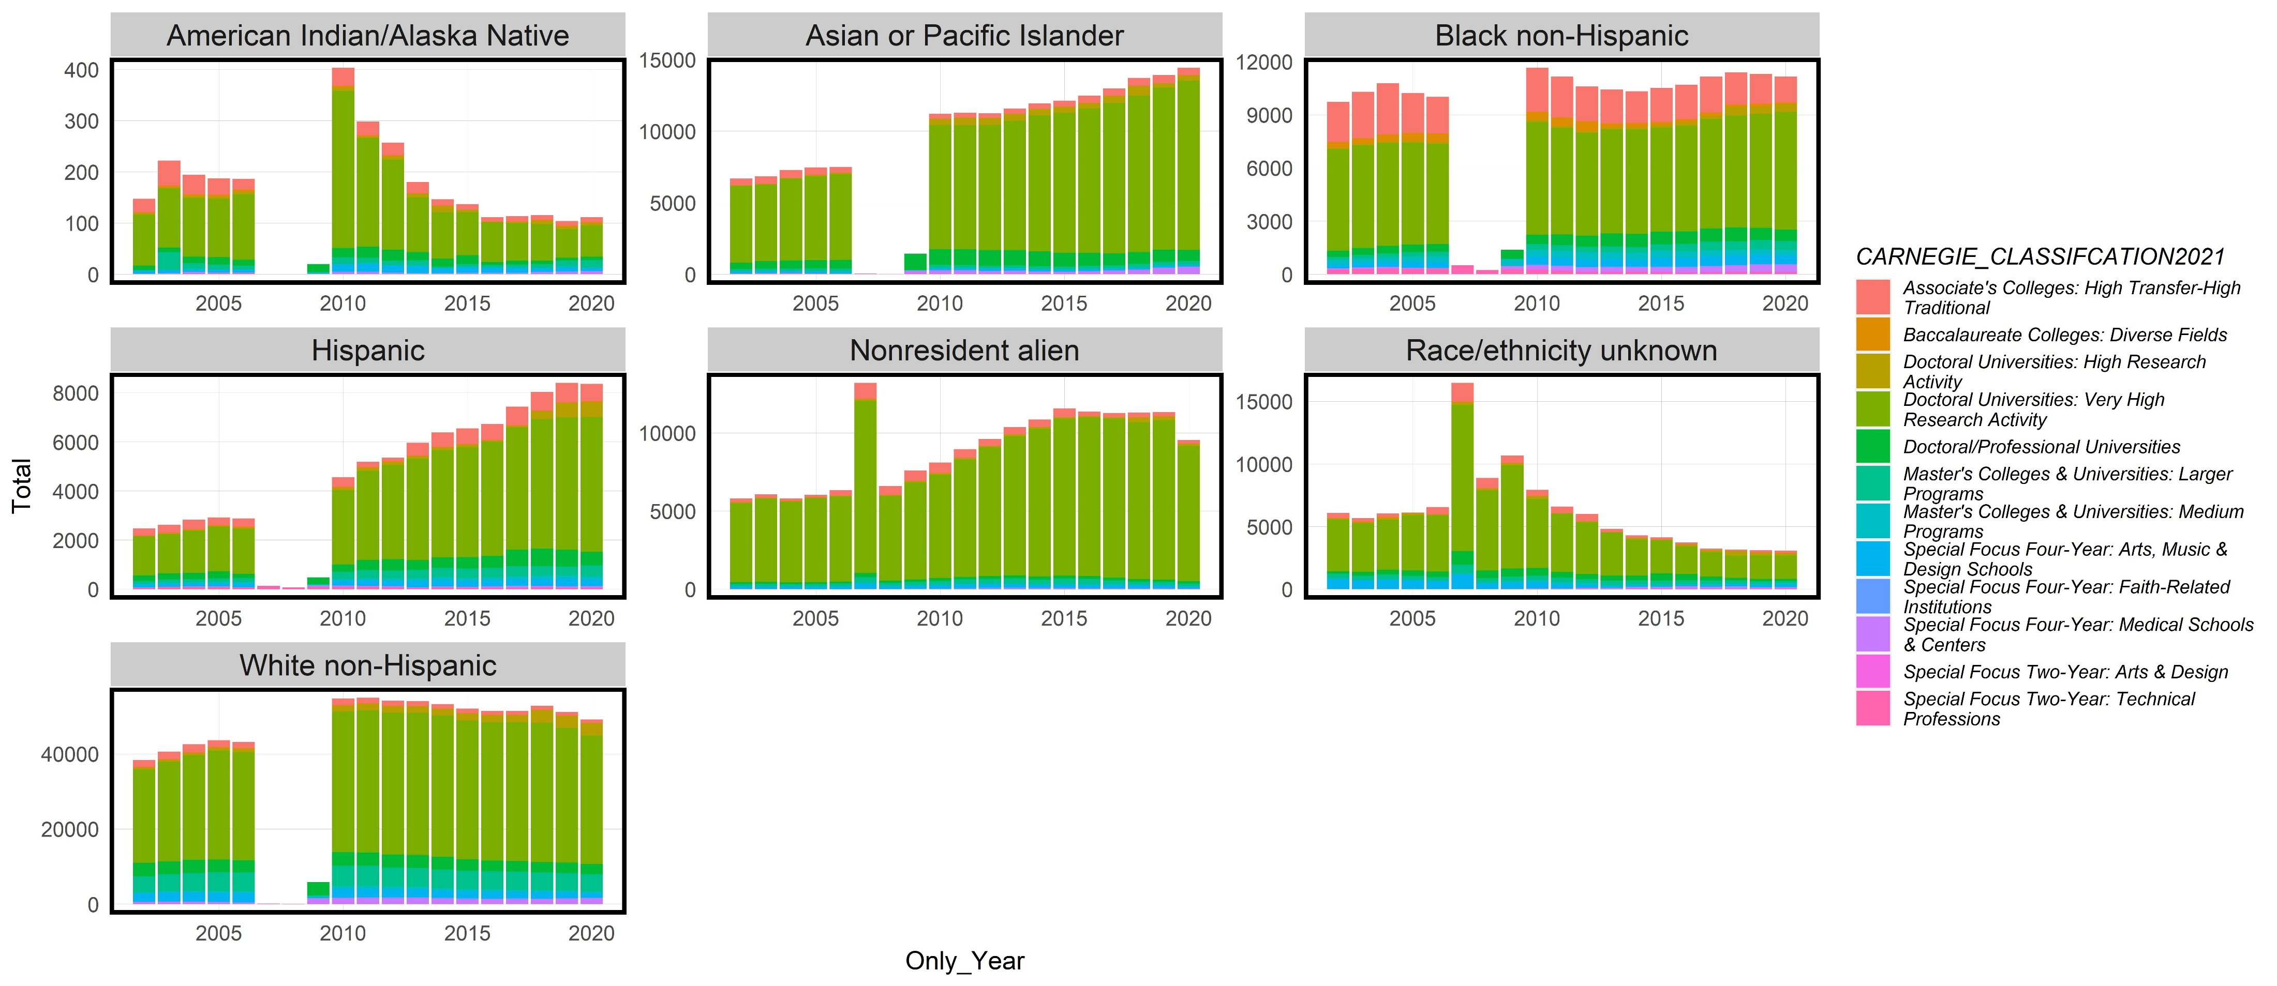
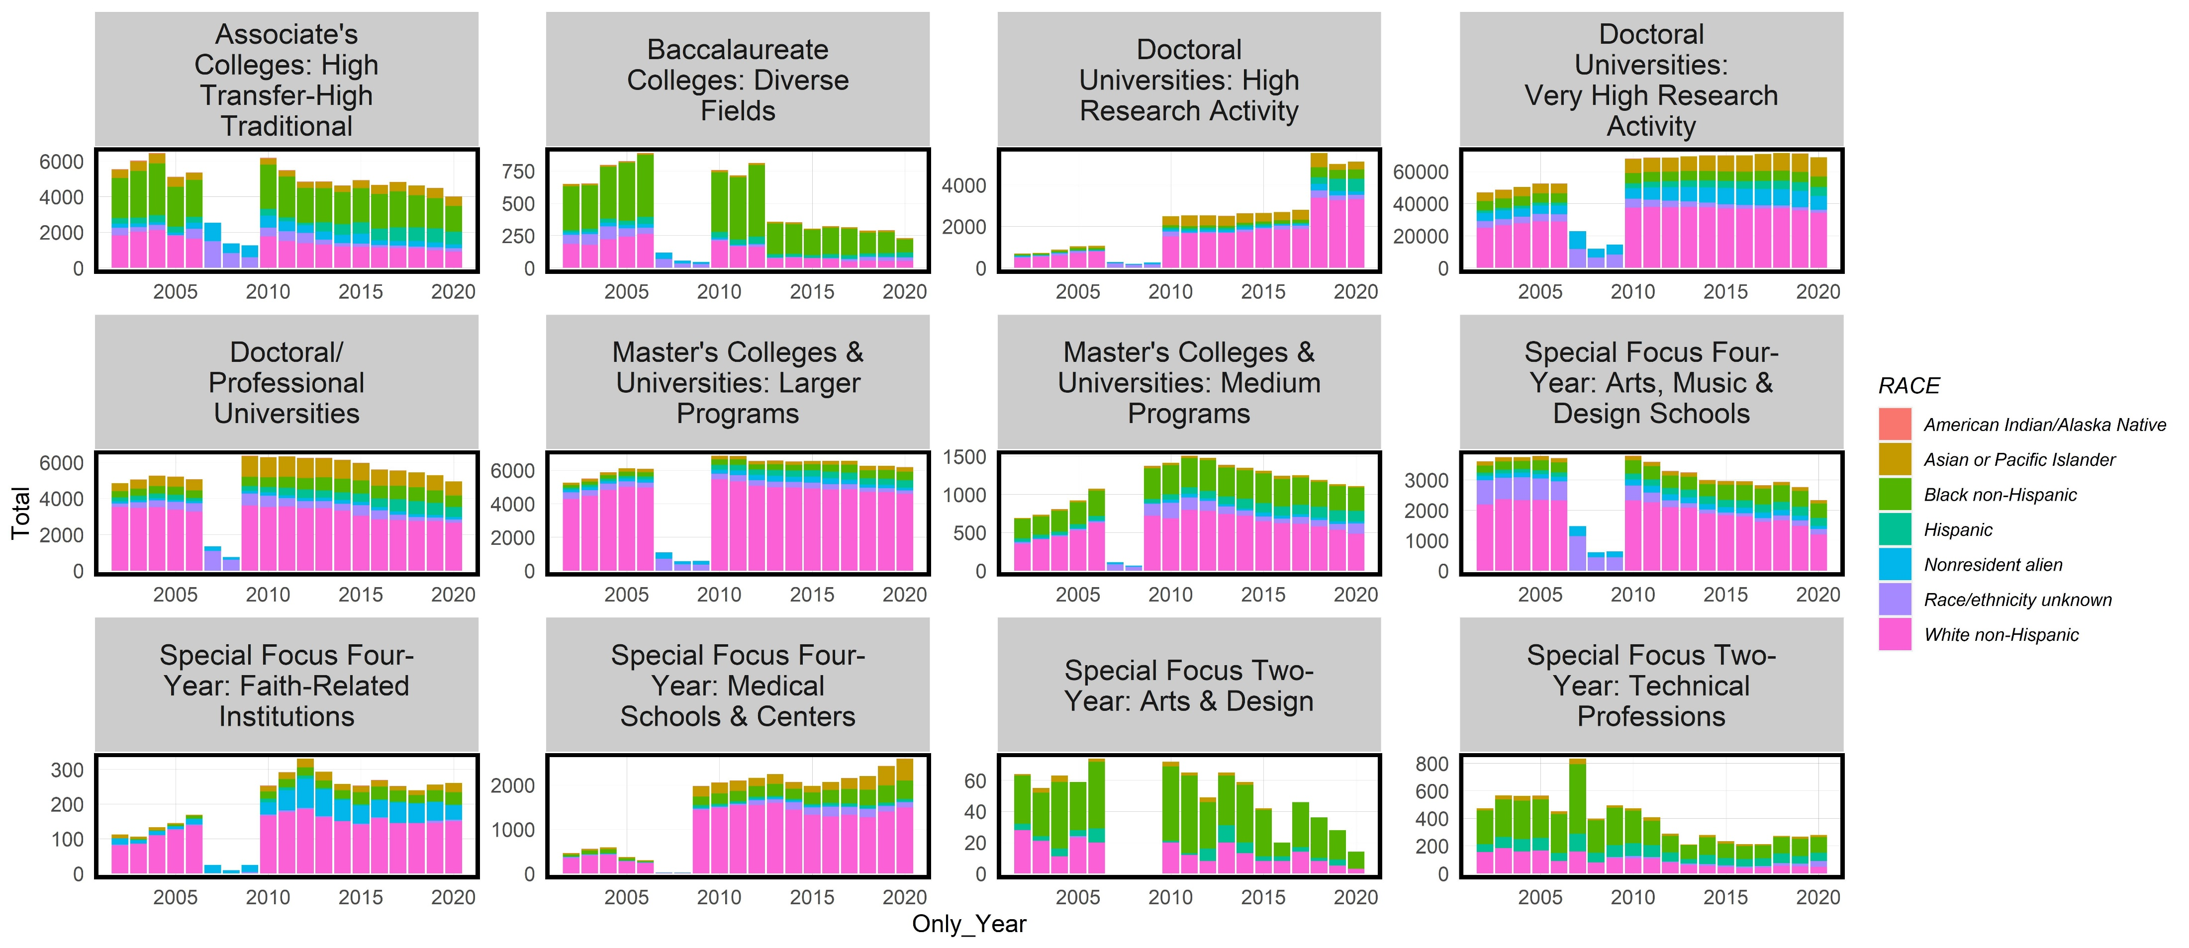
IPEDS Enrollment History

Slide 15
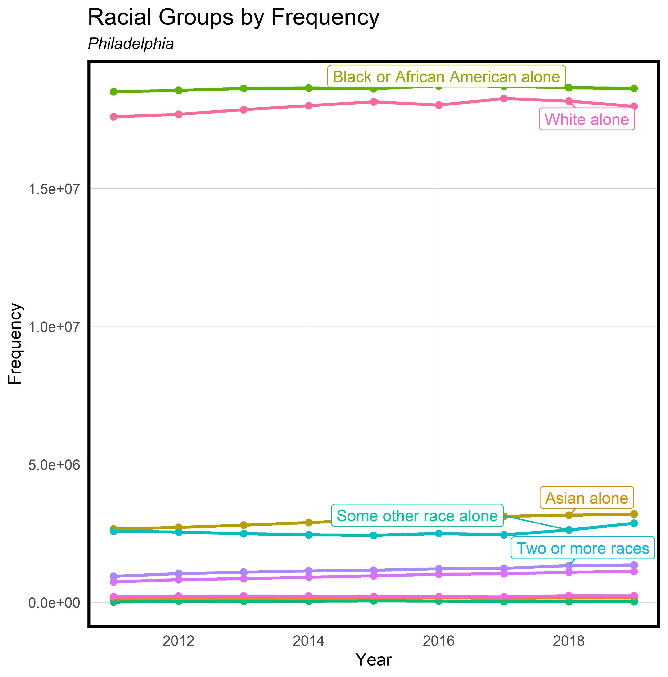
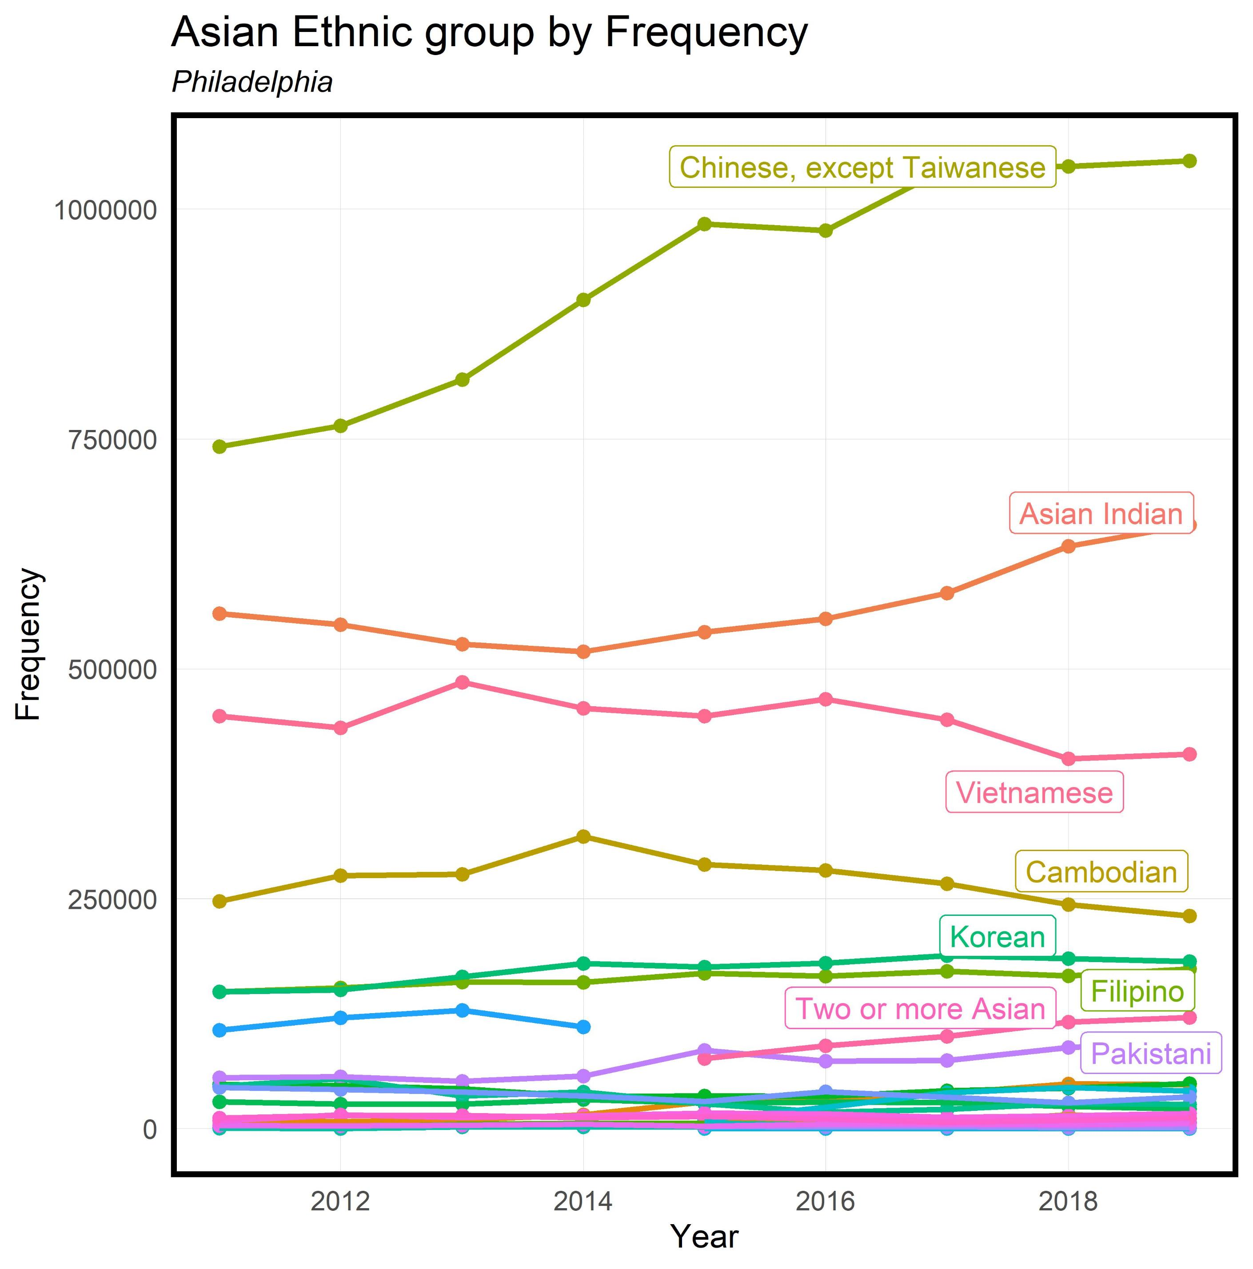
Philadelphia Immigration History
Frequency of Asian Americans is the third highest behind Black and White people in Philadelphia
Of the Asian population, the most growth was with Chinese people

Slide 16
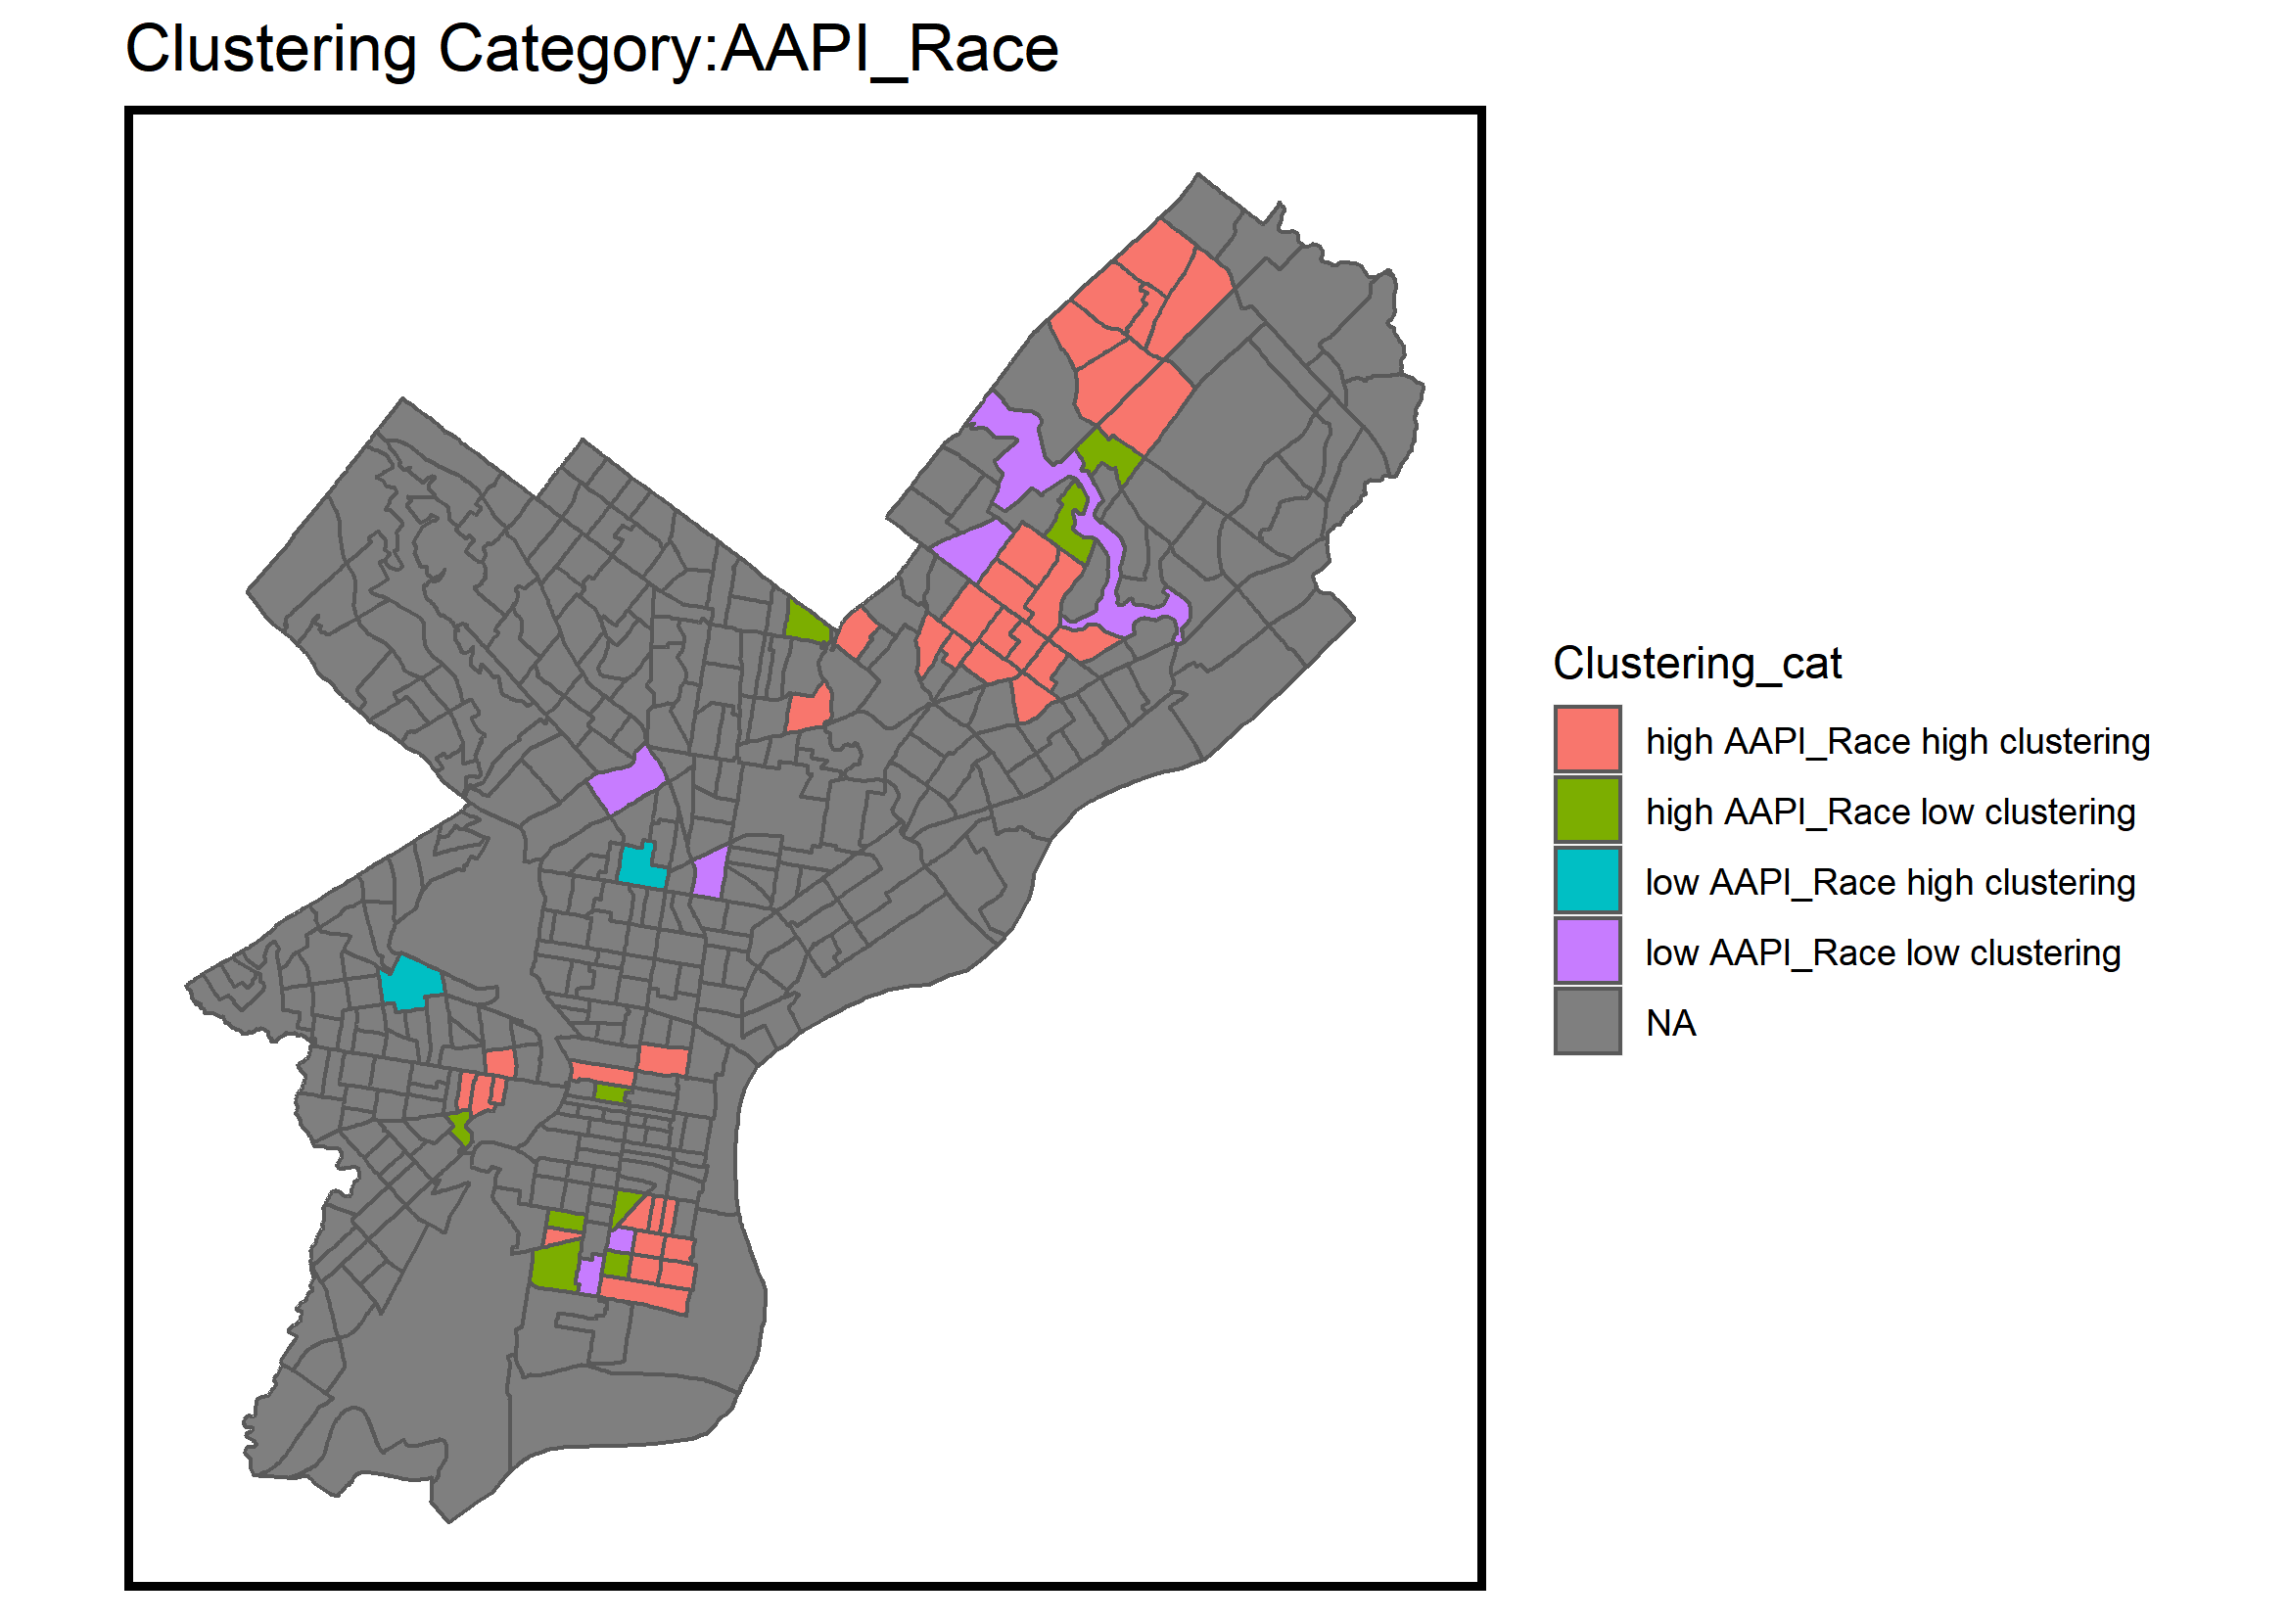
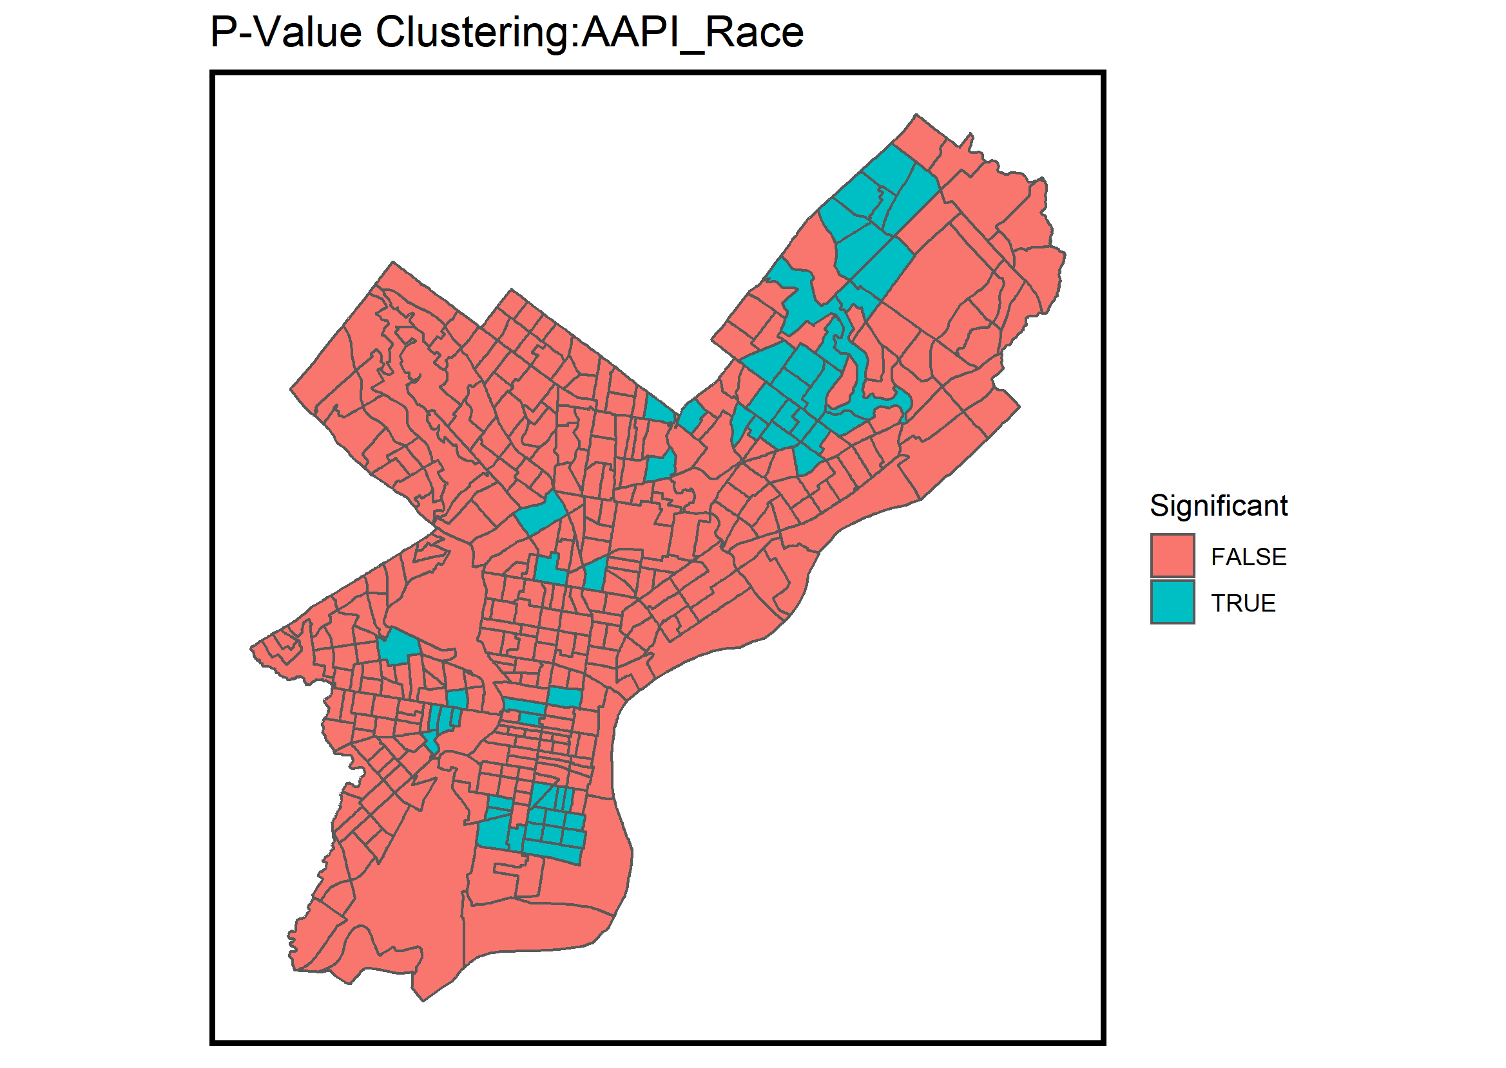
Moran’s I
Are Asian Americans Clustered?

Slide 17
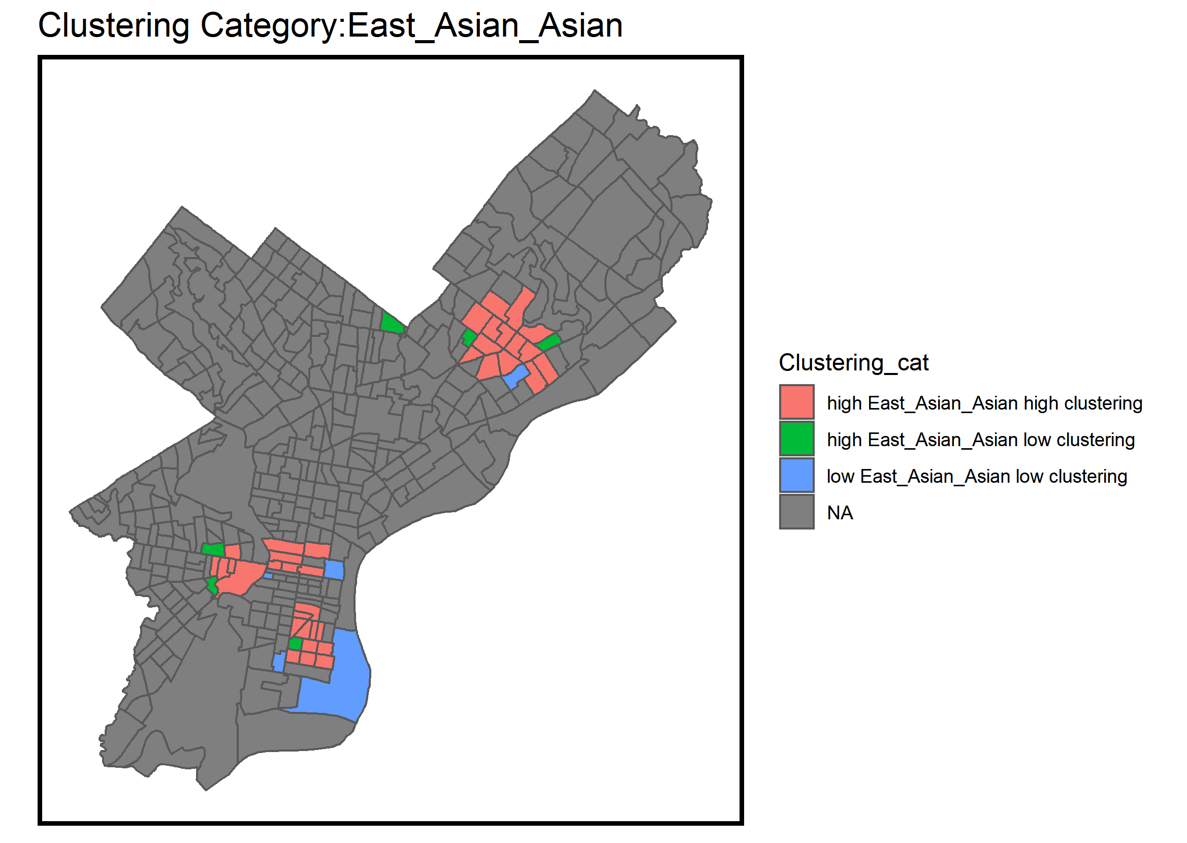
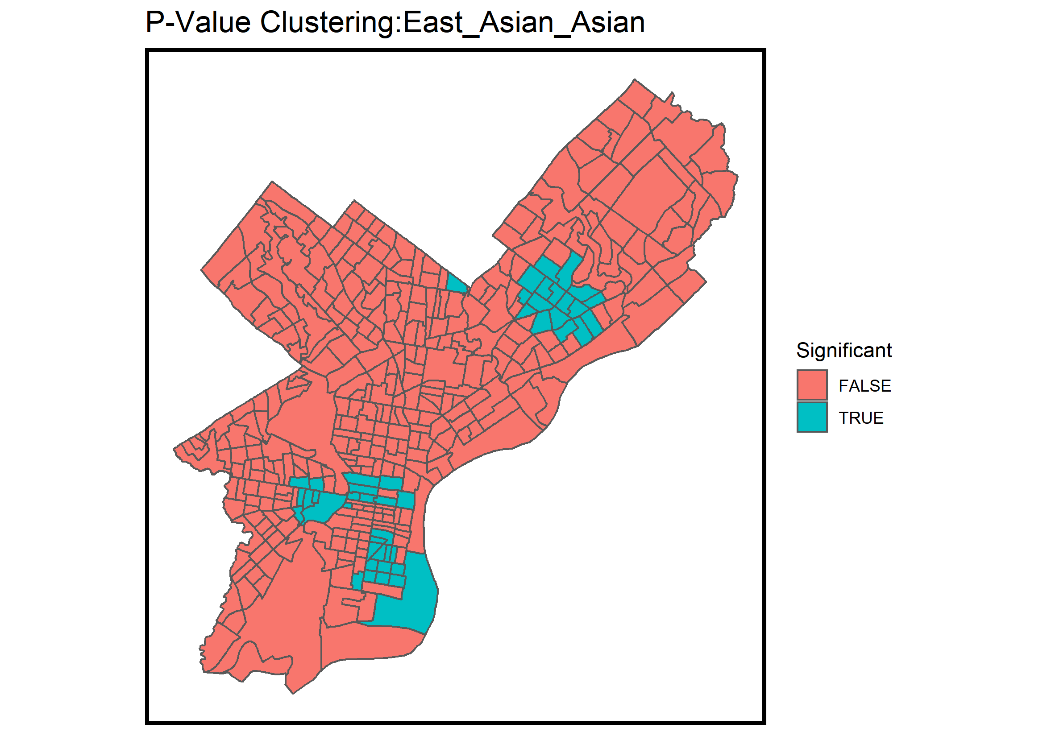
Moran’s I
Are Asian Americans Clustered?

Slide 18
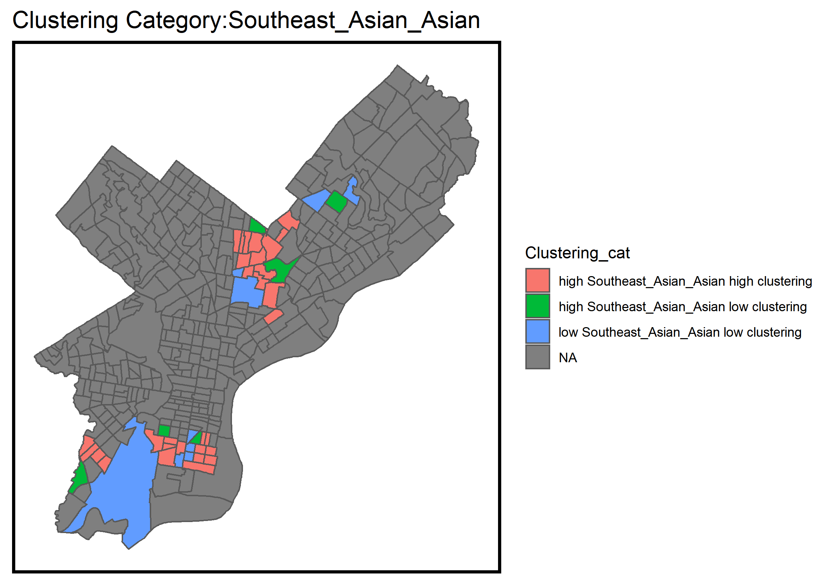
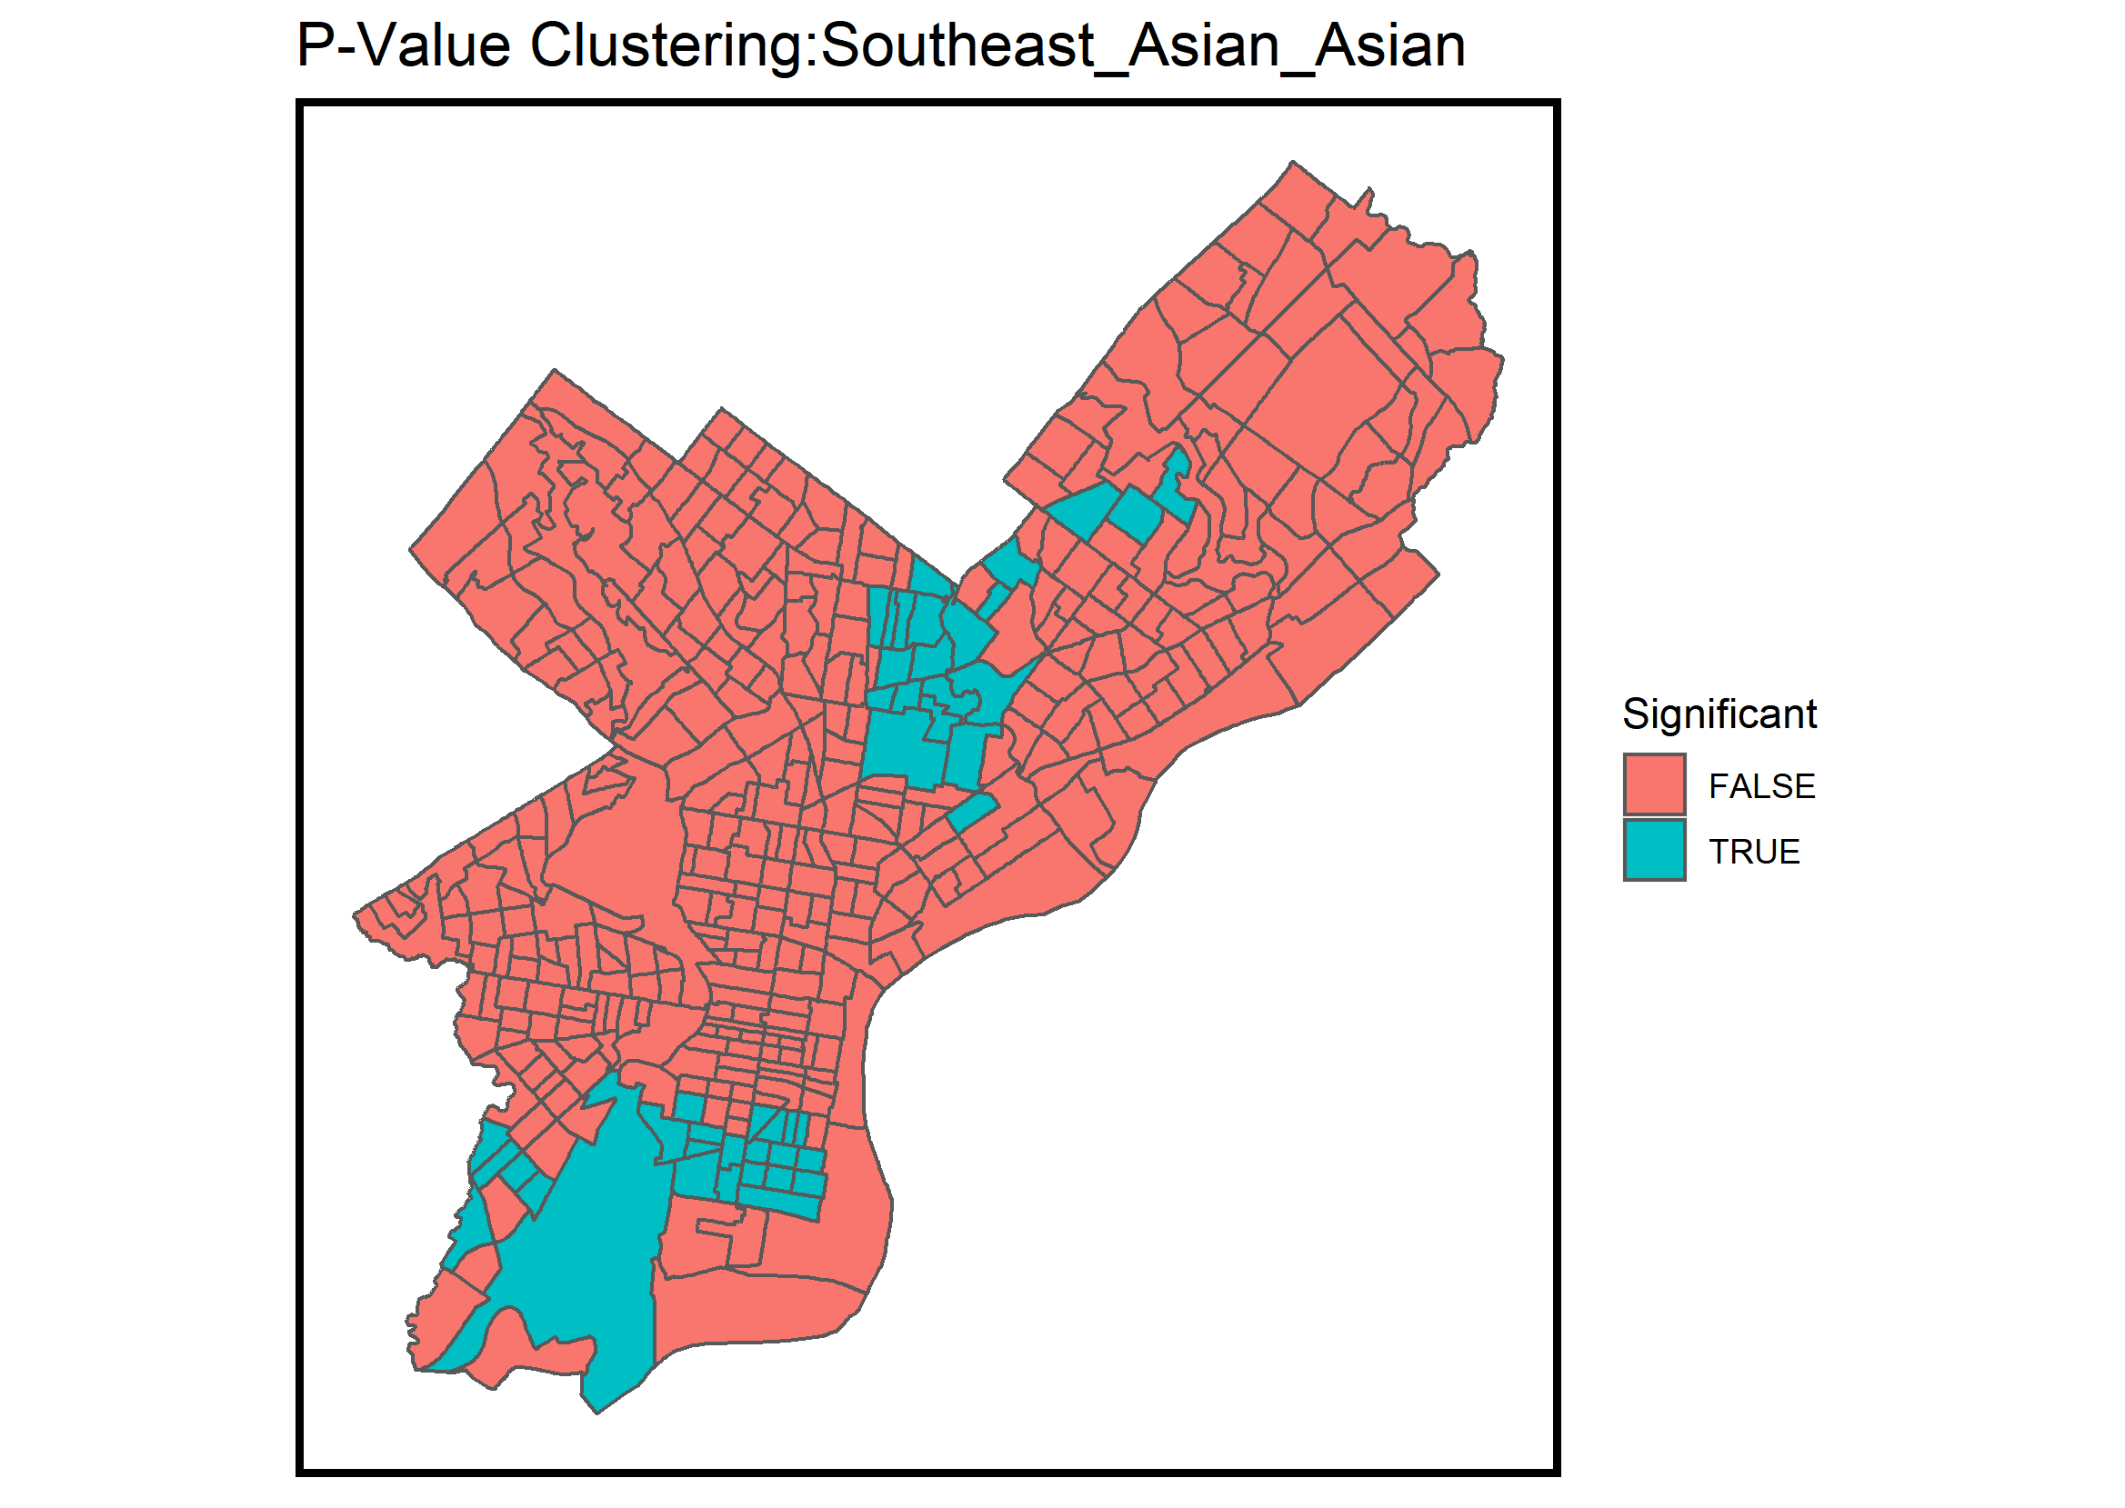
Moran’s I
Are Asian Americans Clustered?

Slide 19
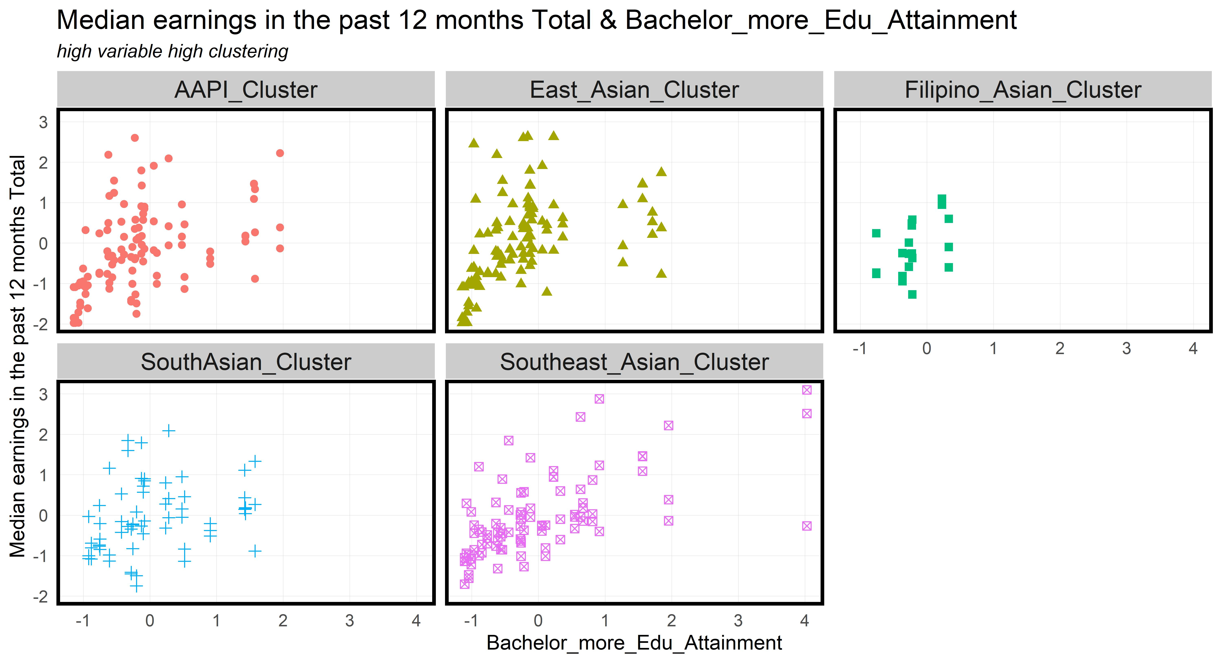
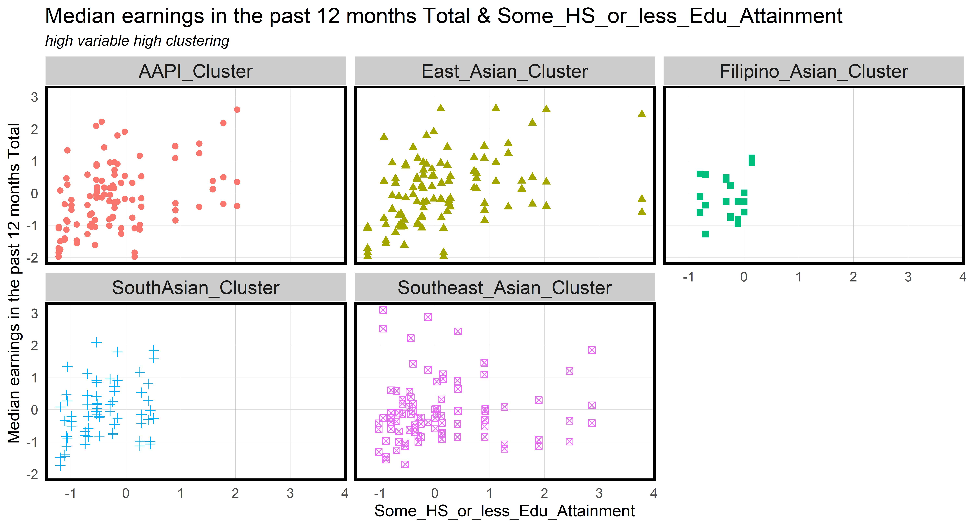
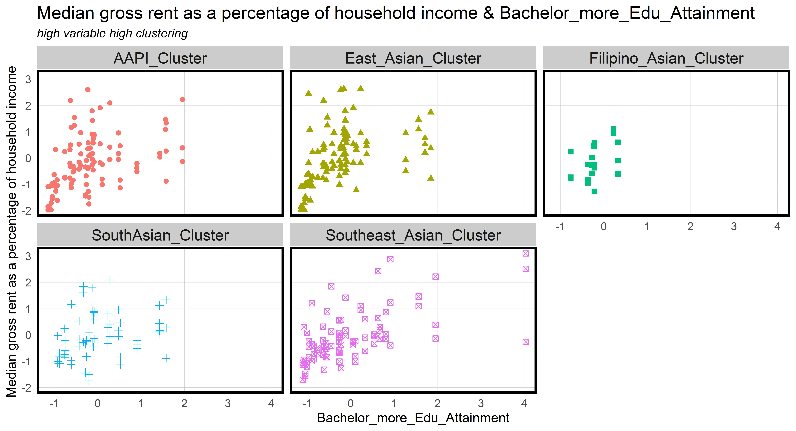
High Frequency and High Clustering
Scatterplots of Environmental Conditions

Slide 20
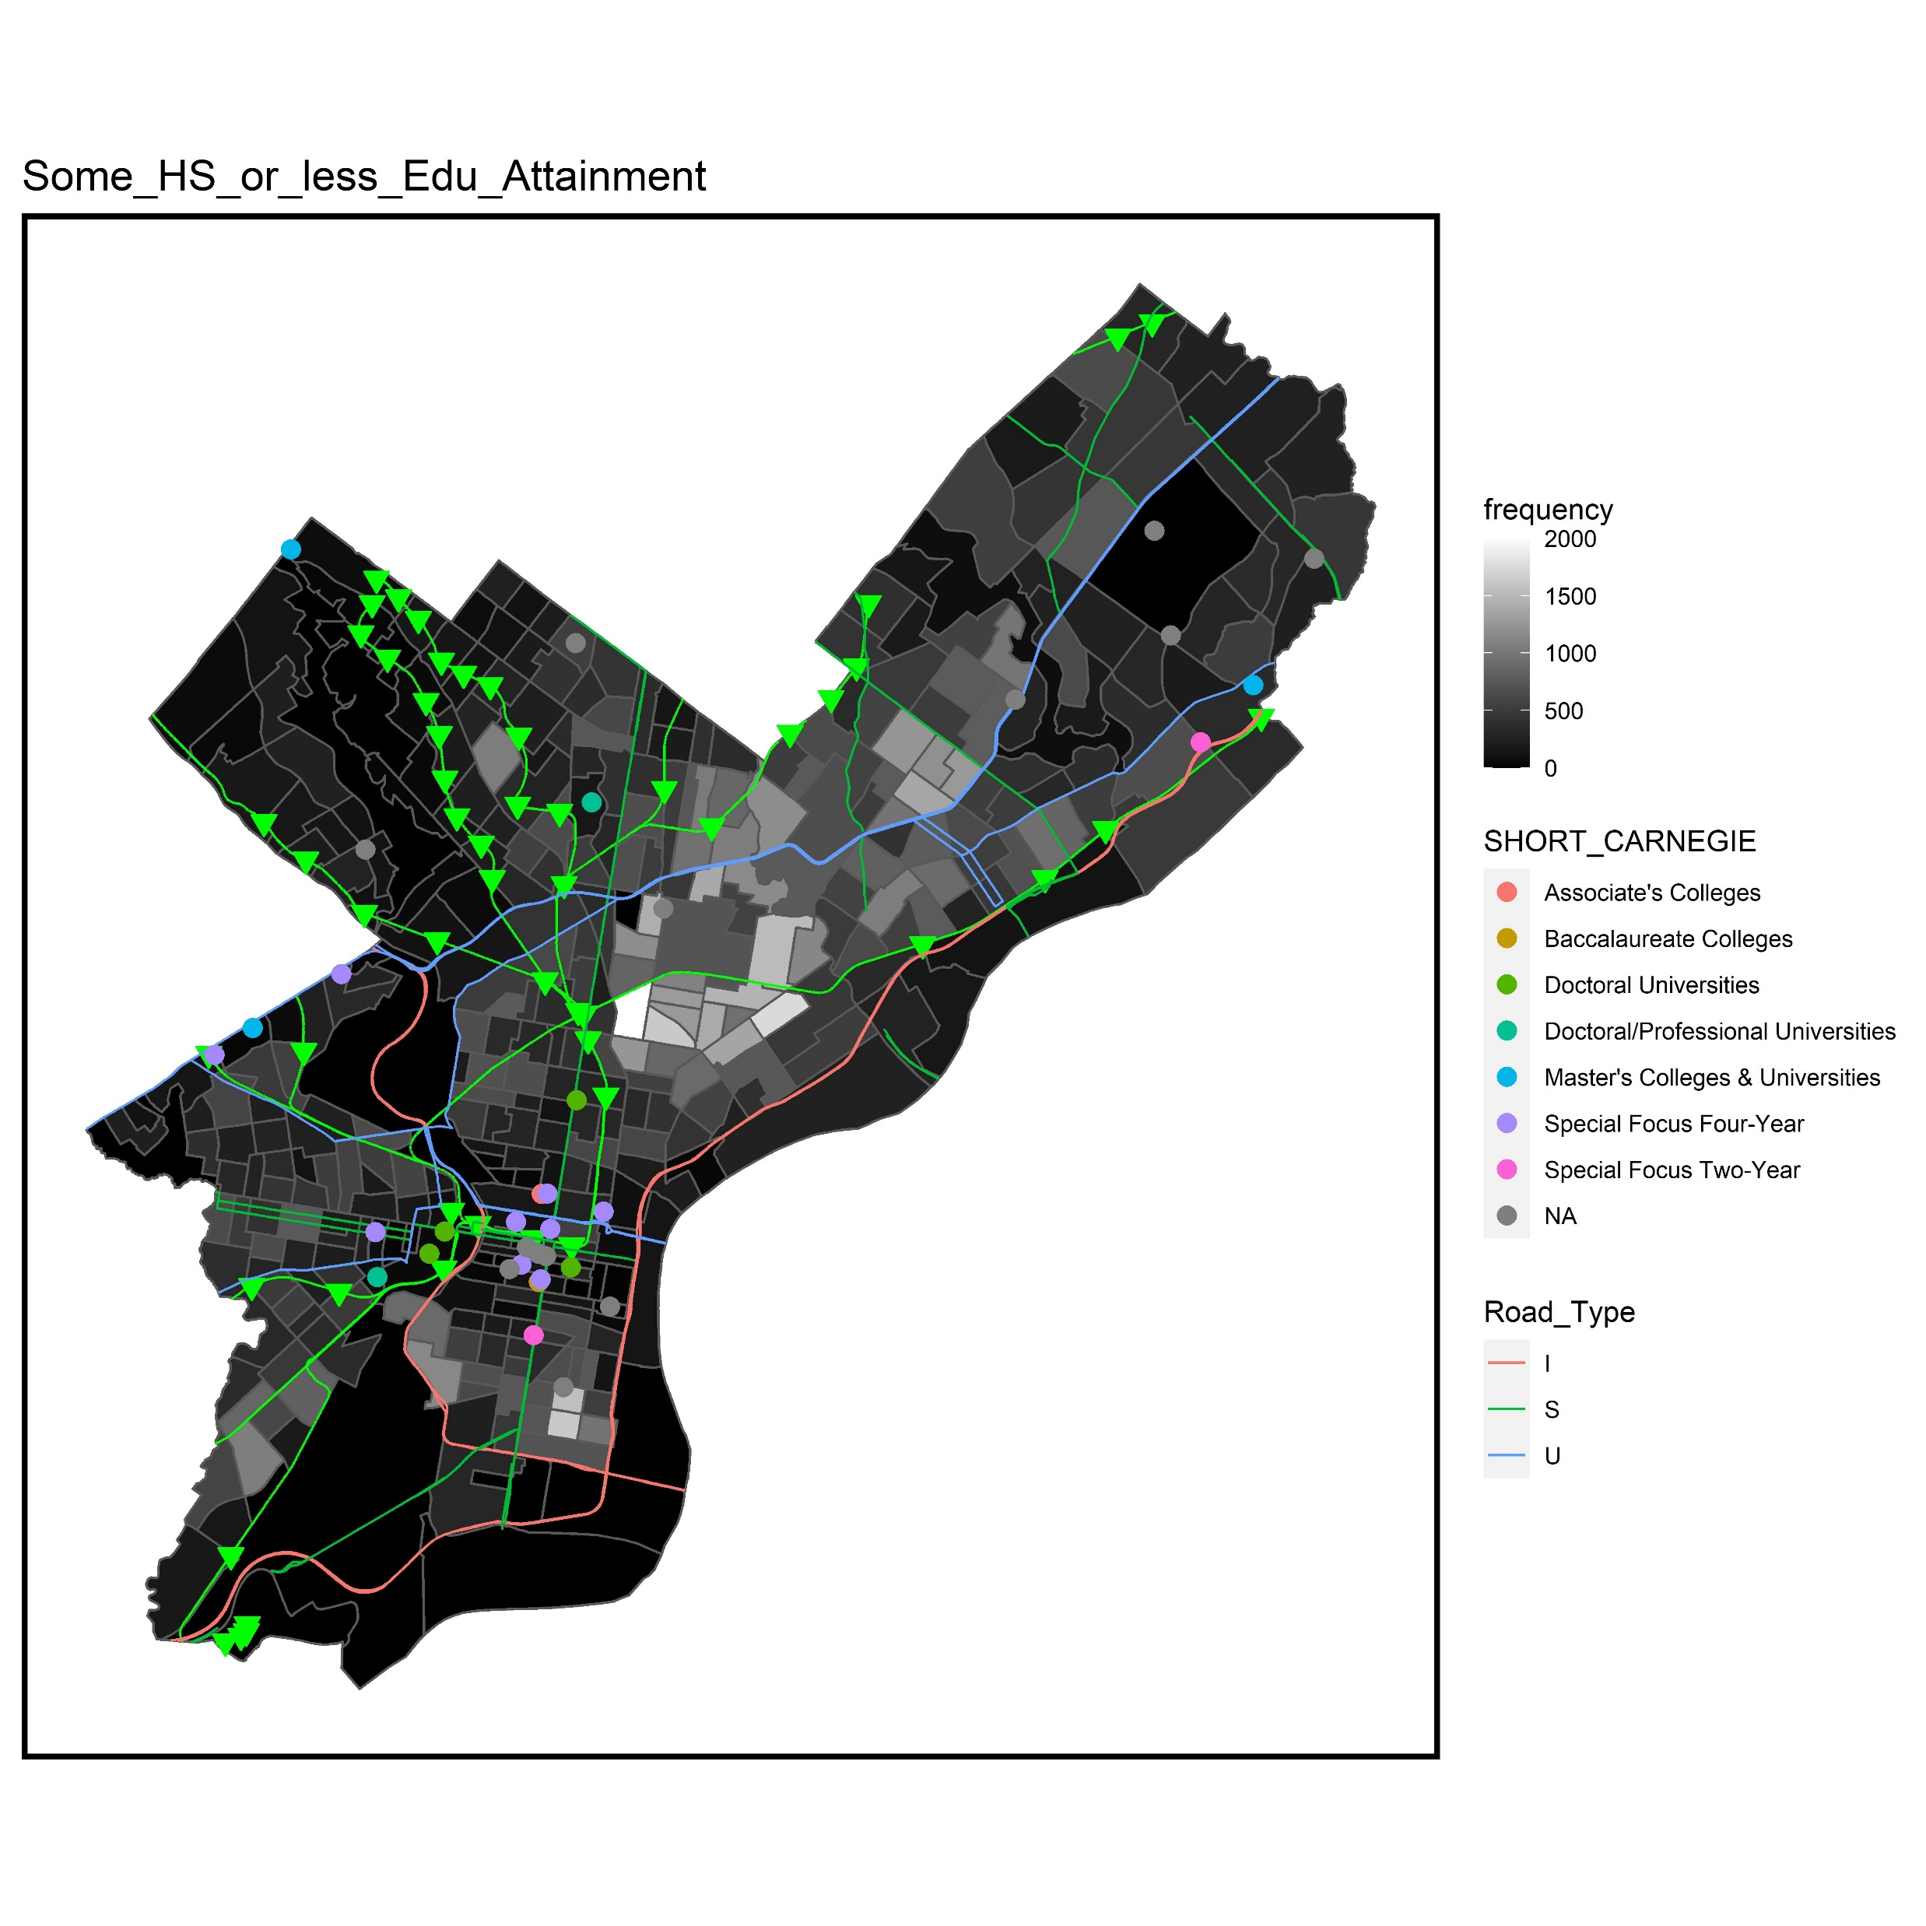
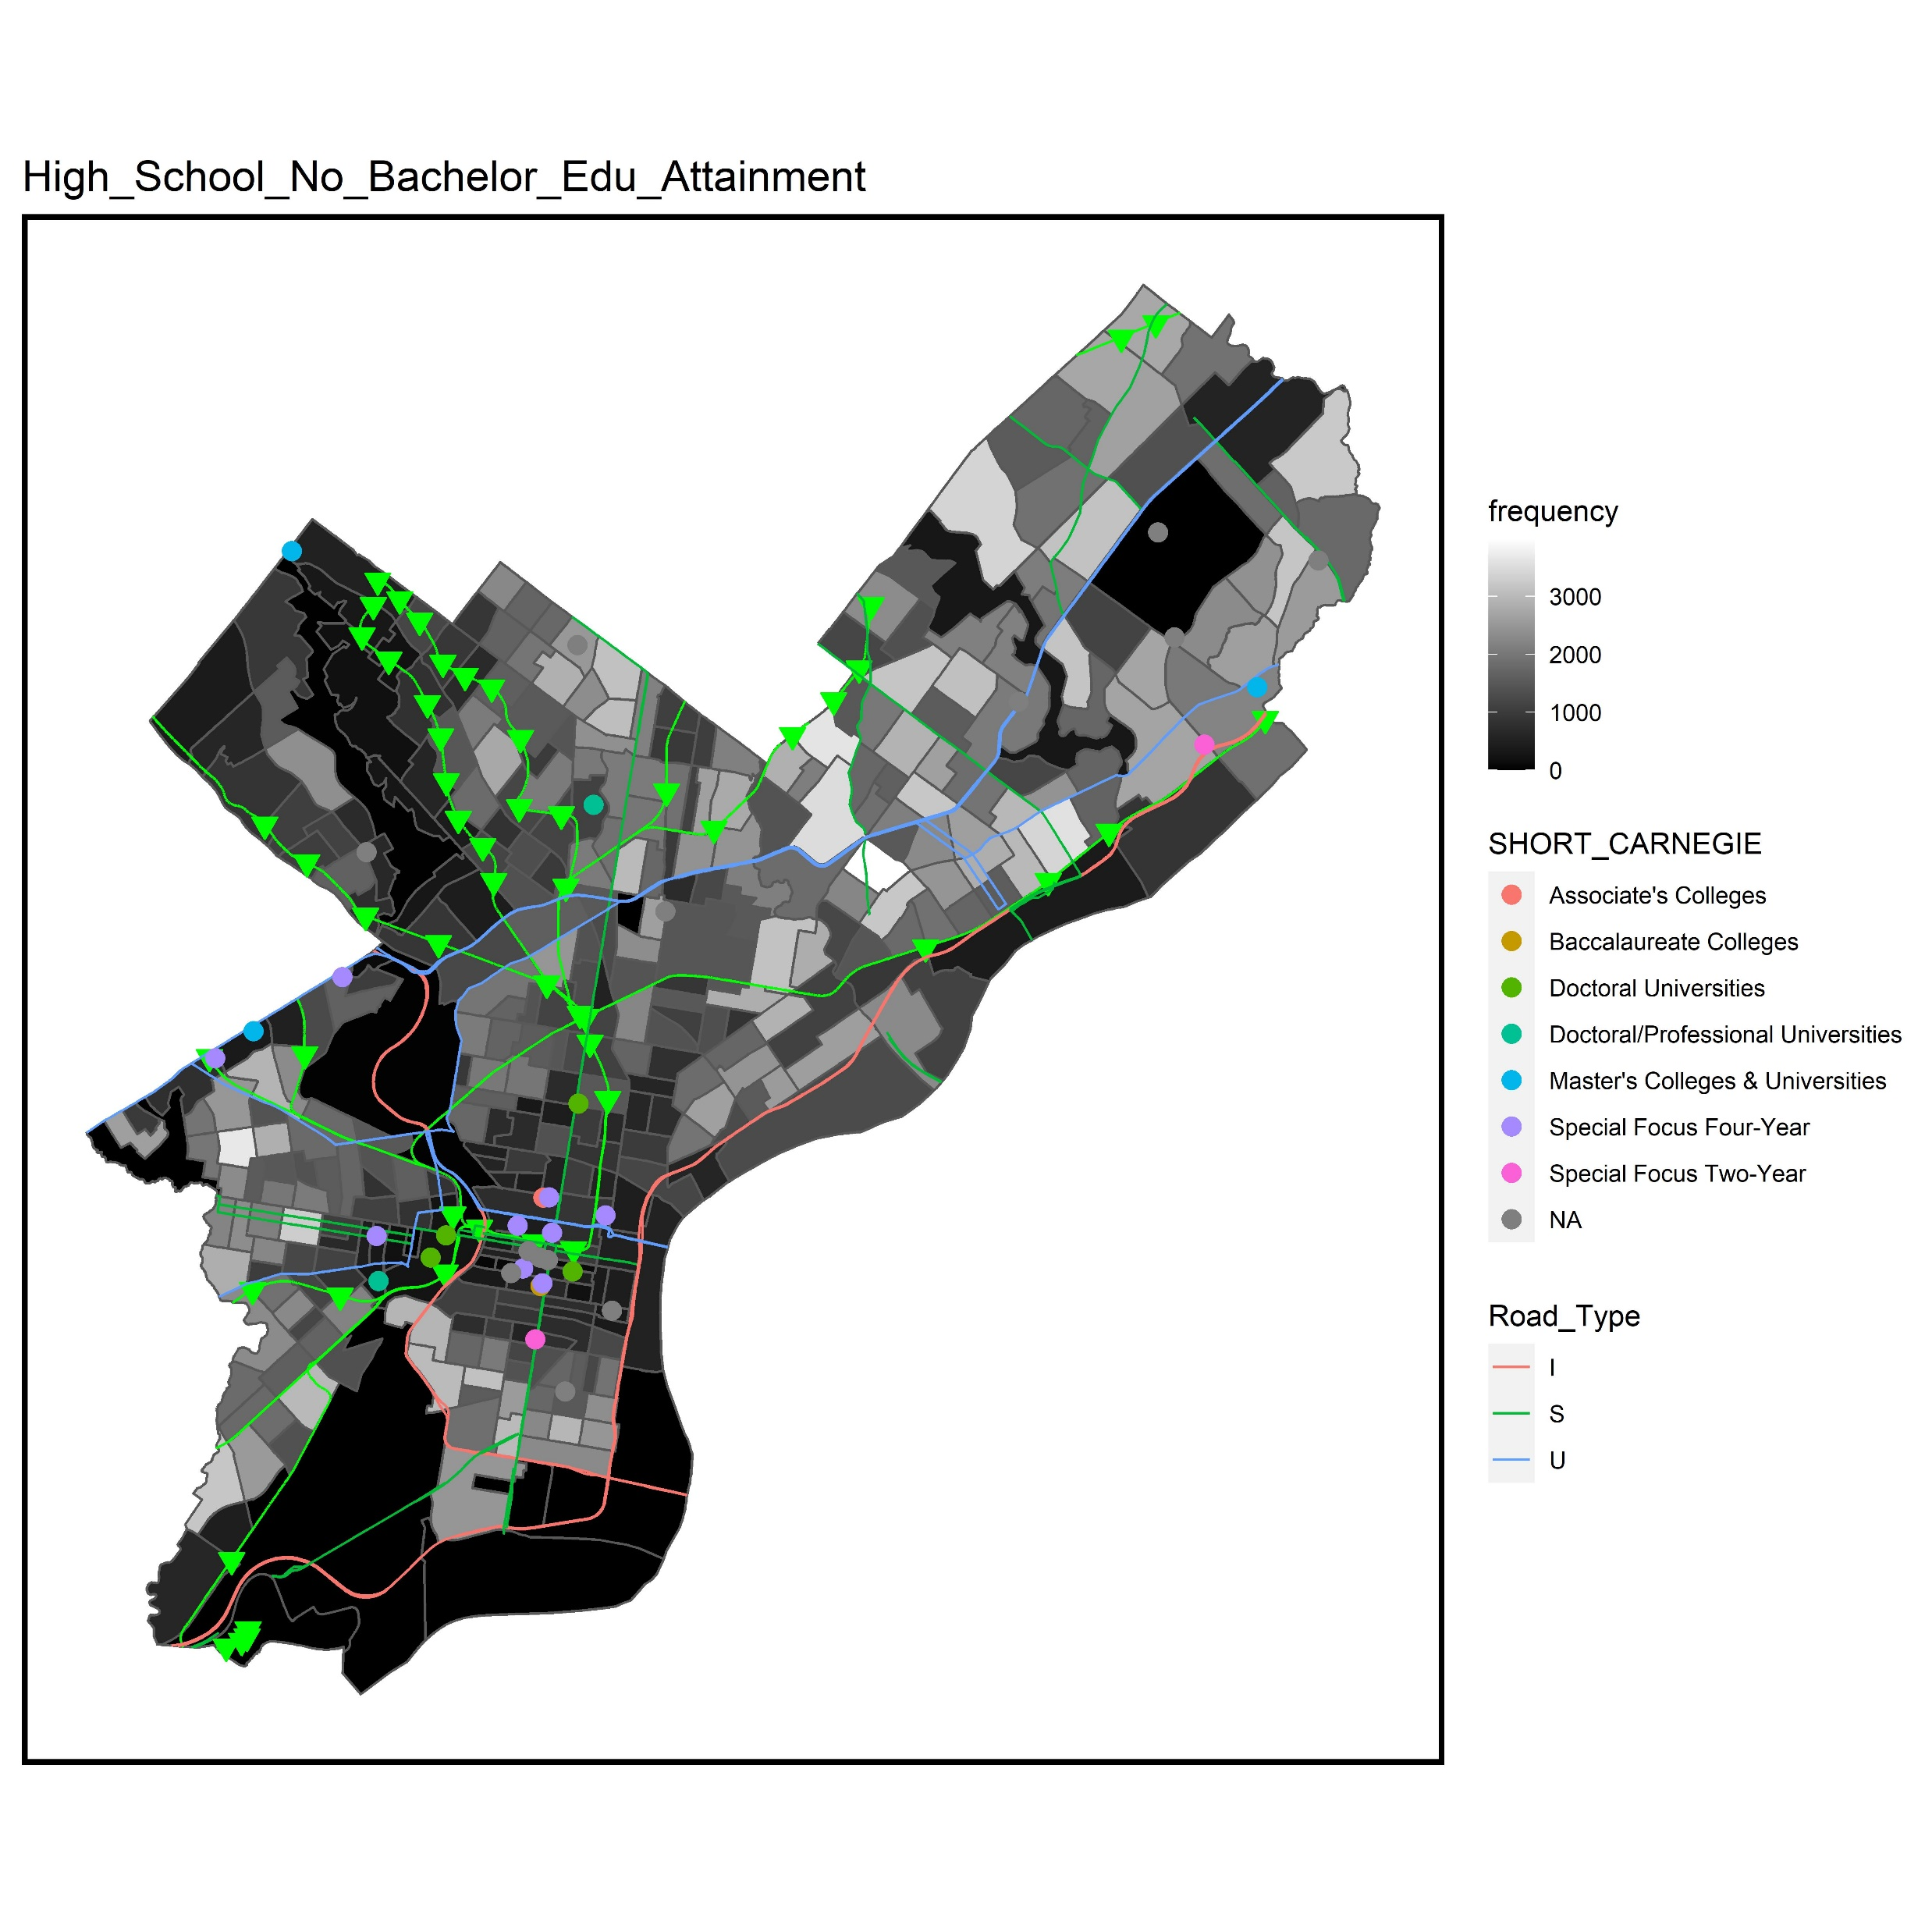
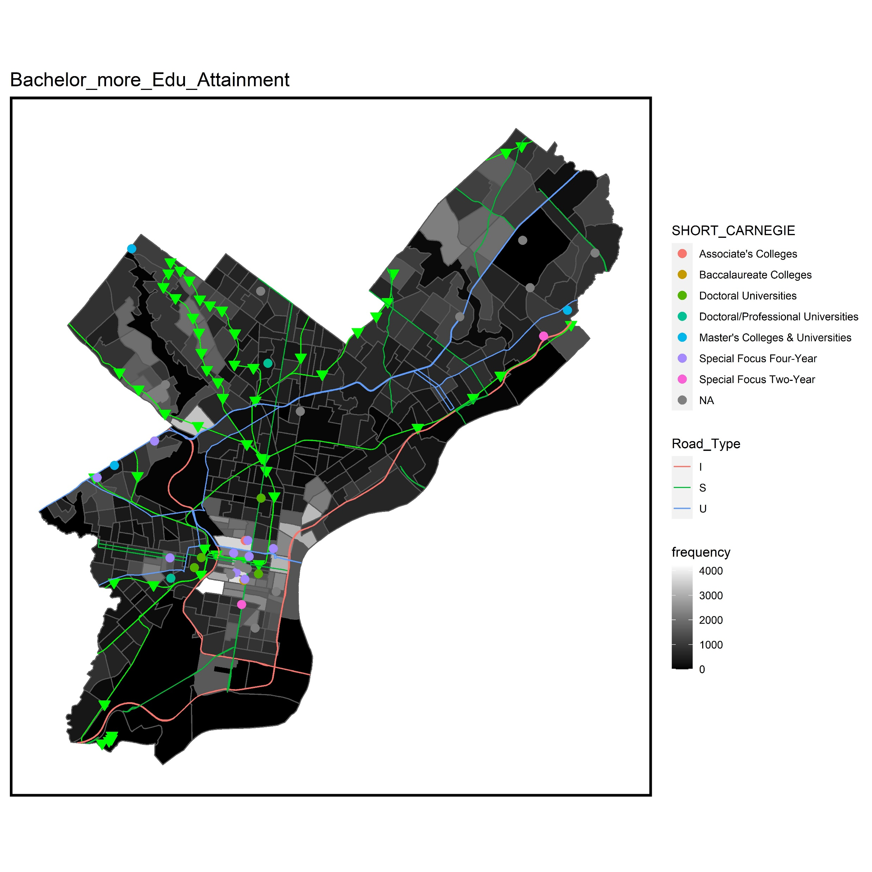
Frequency of Education Attainment

Slide 21
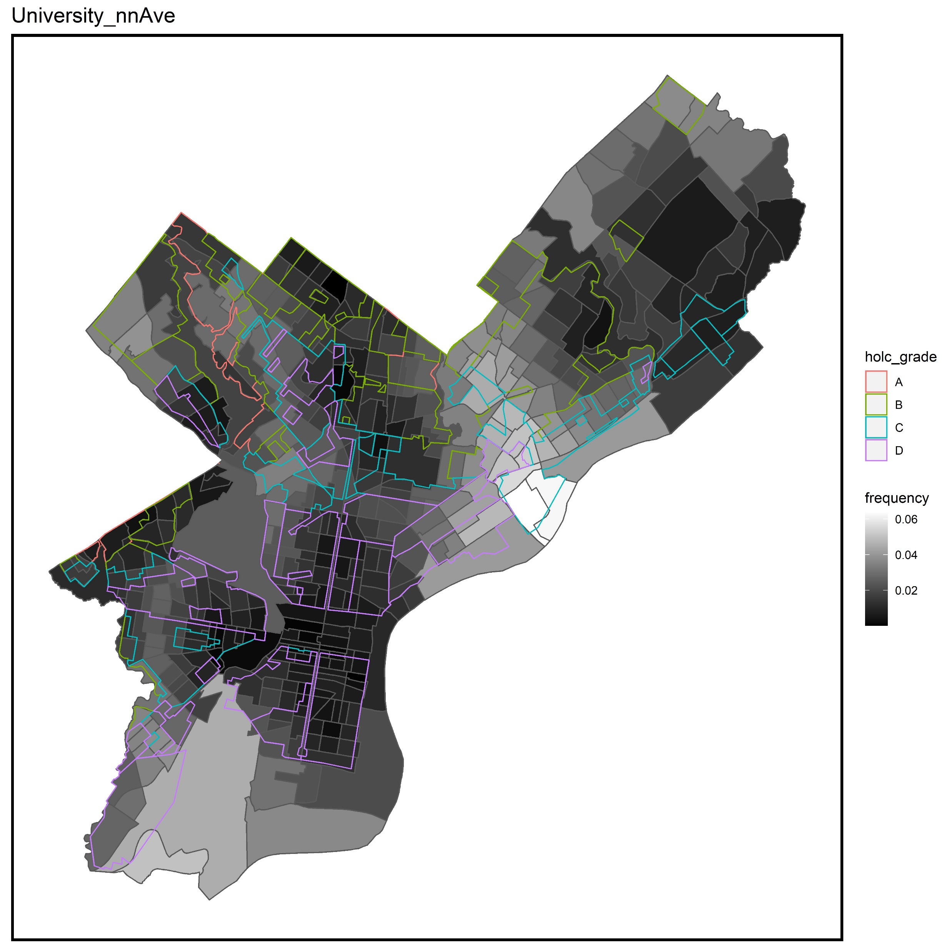
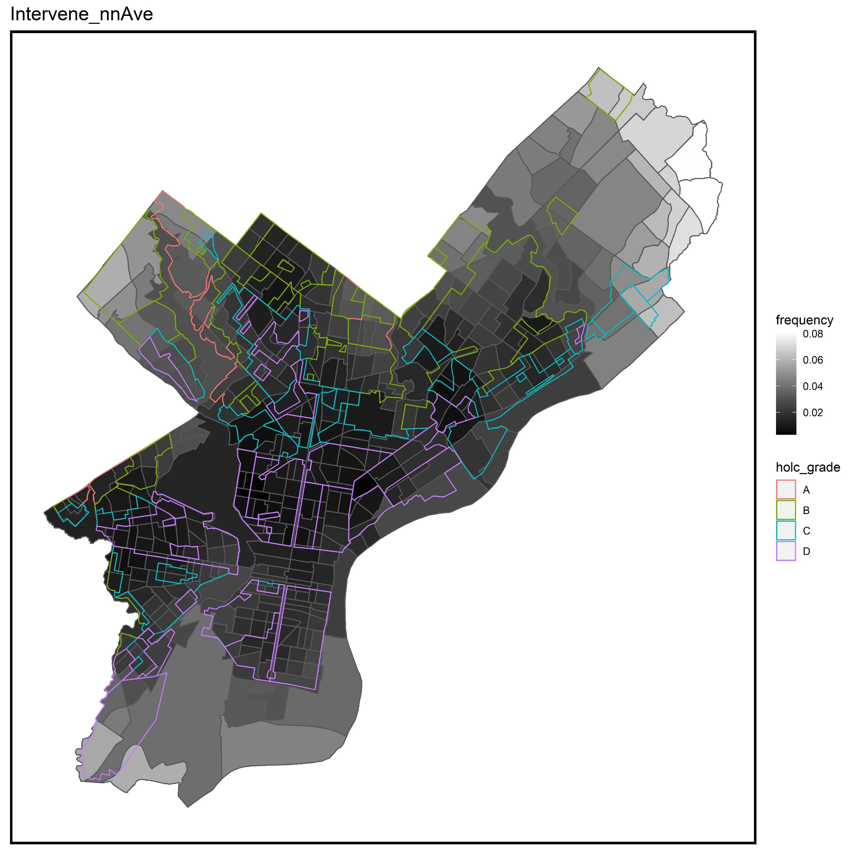
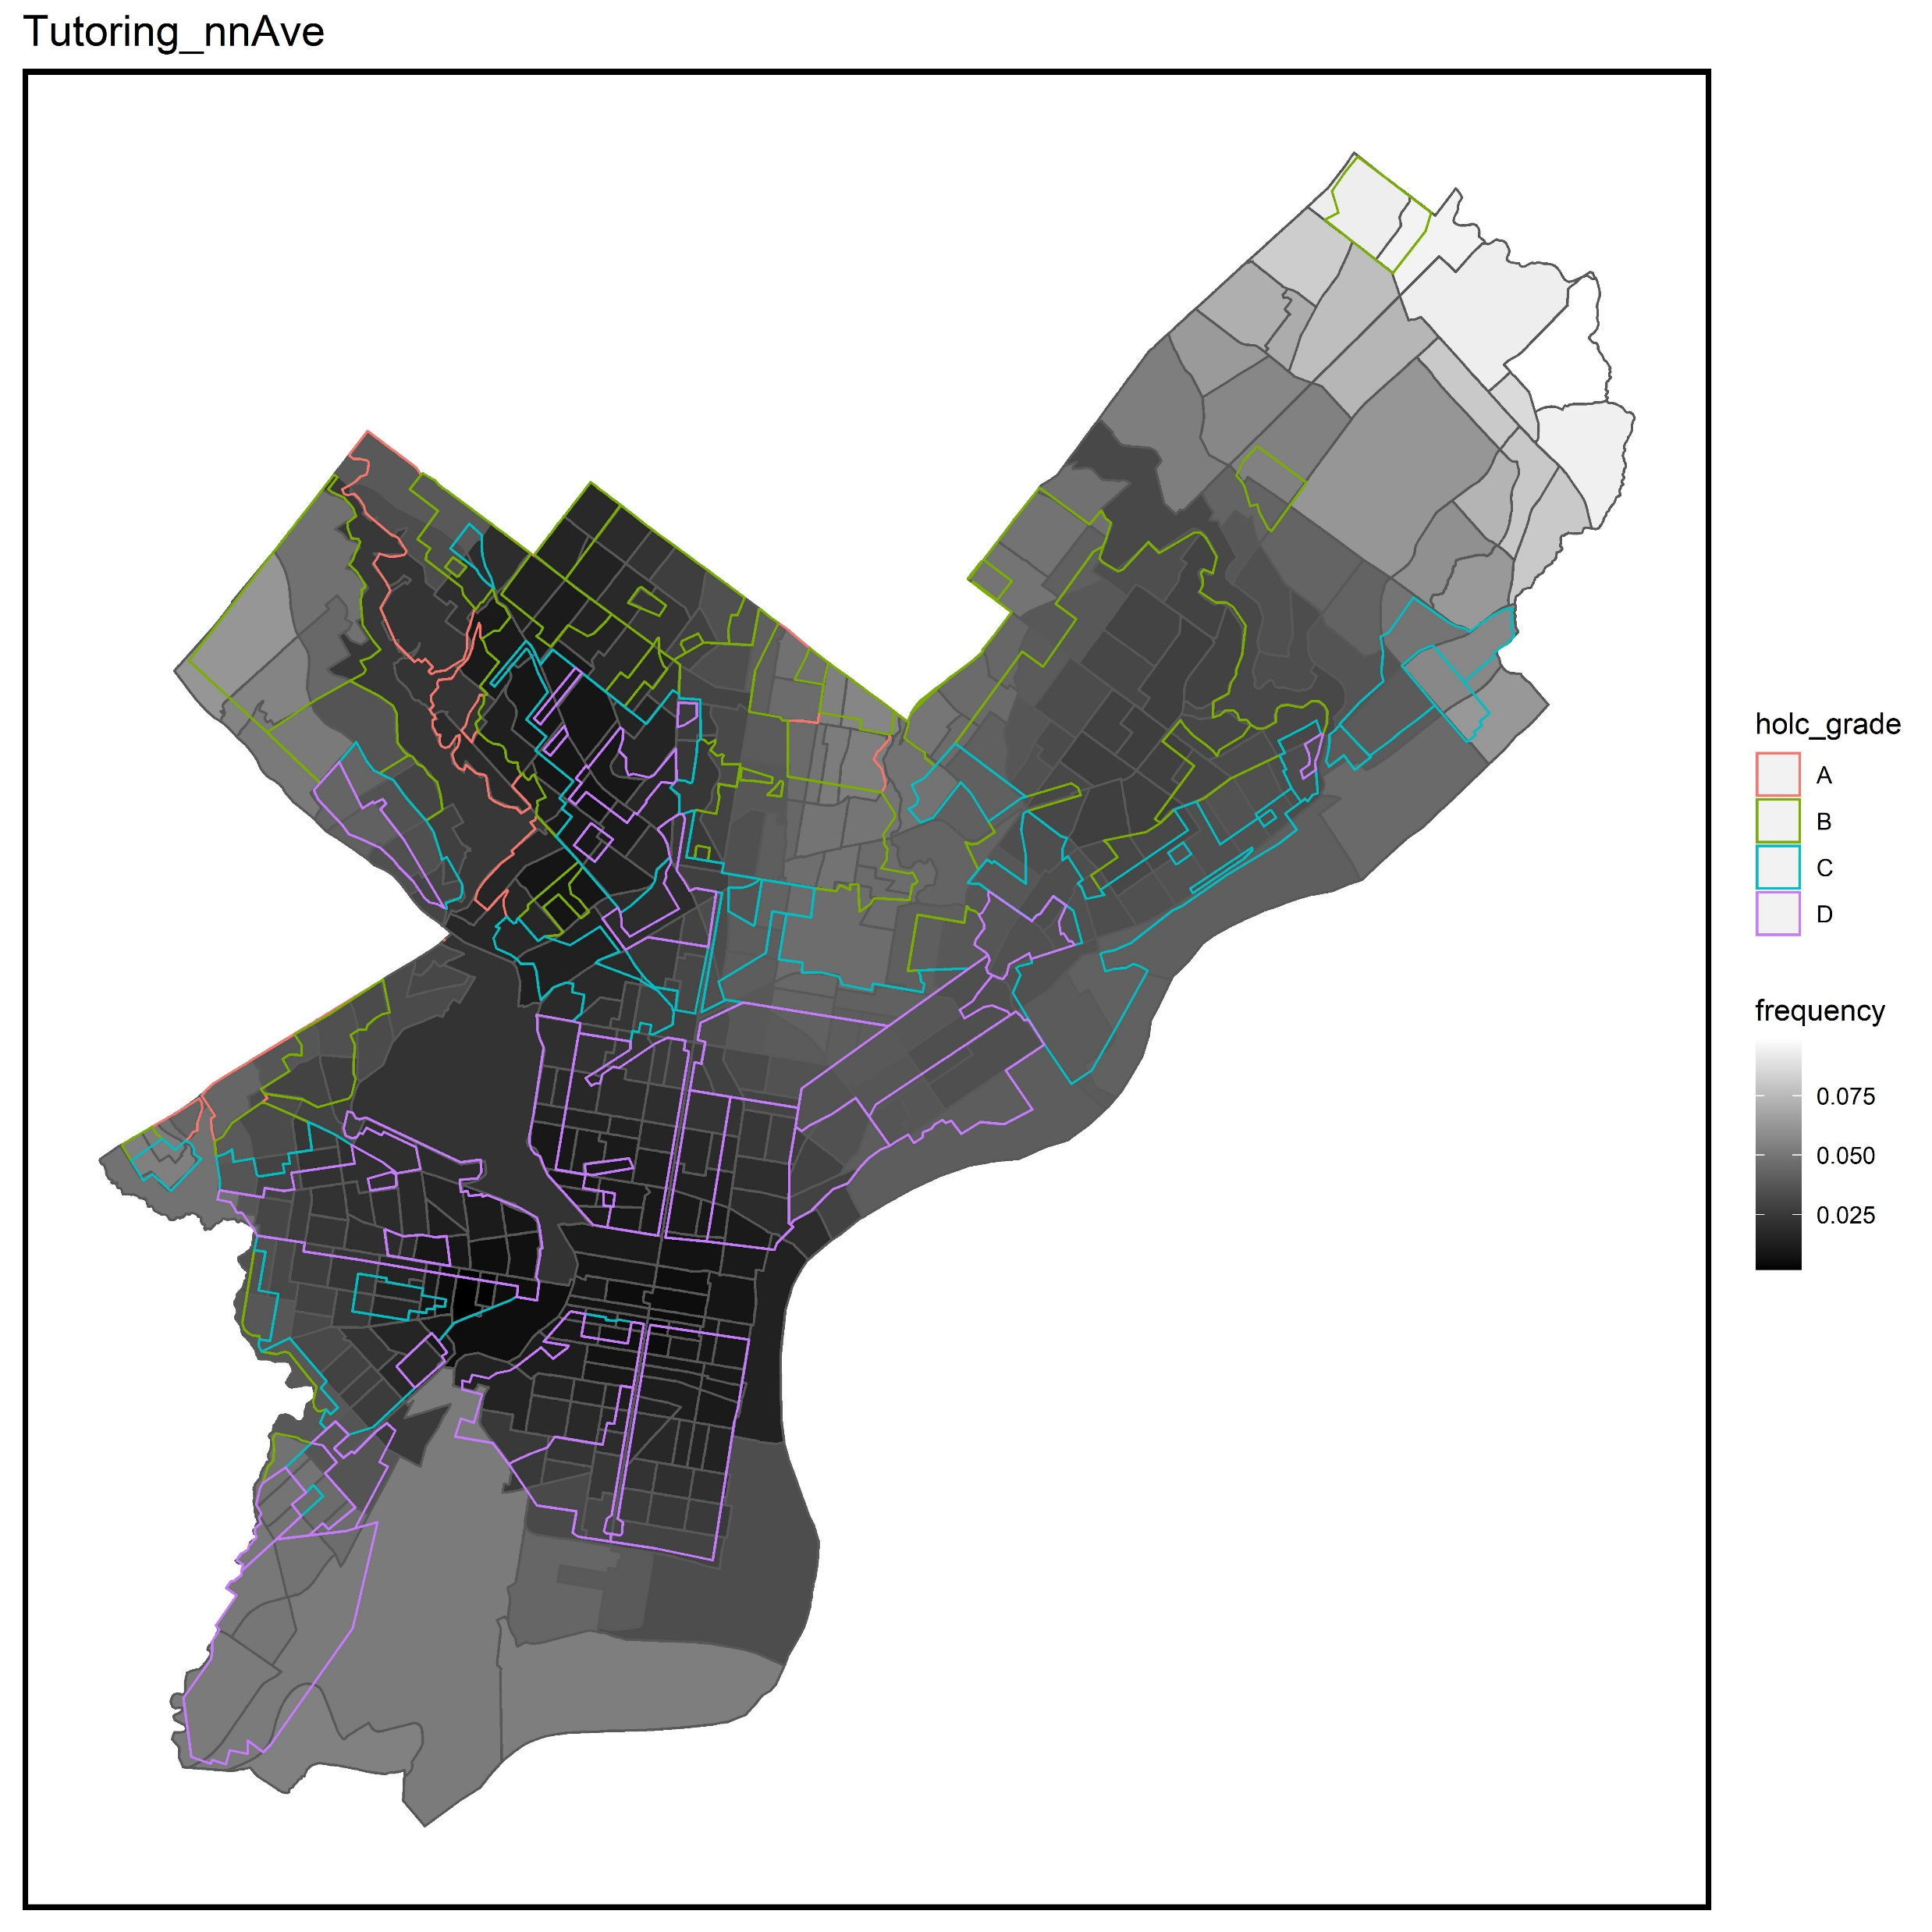
Nearest Neighbor Average

Slide 22
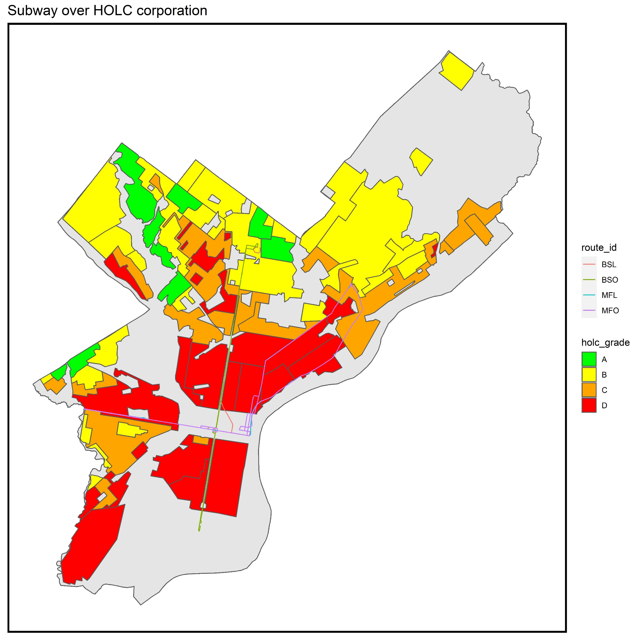
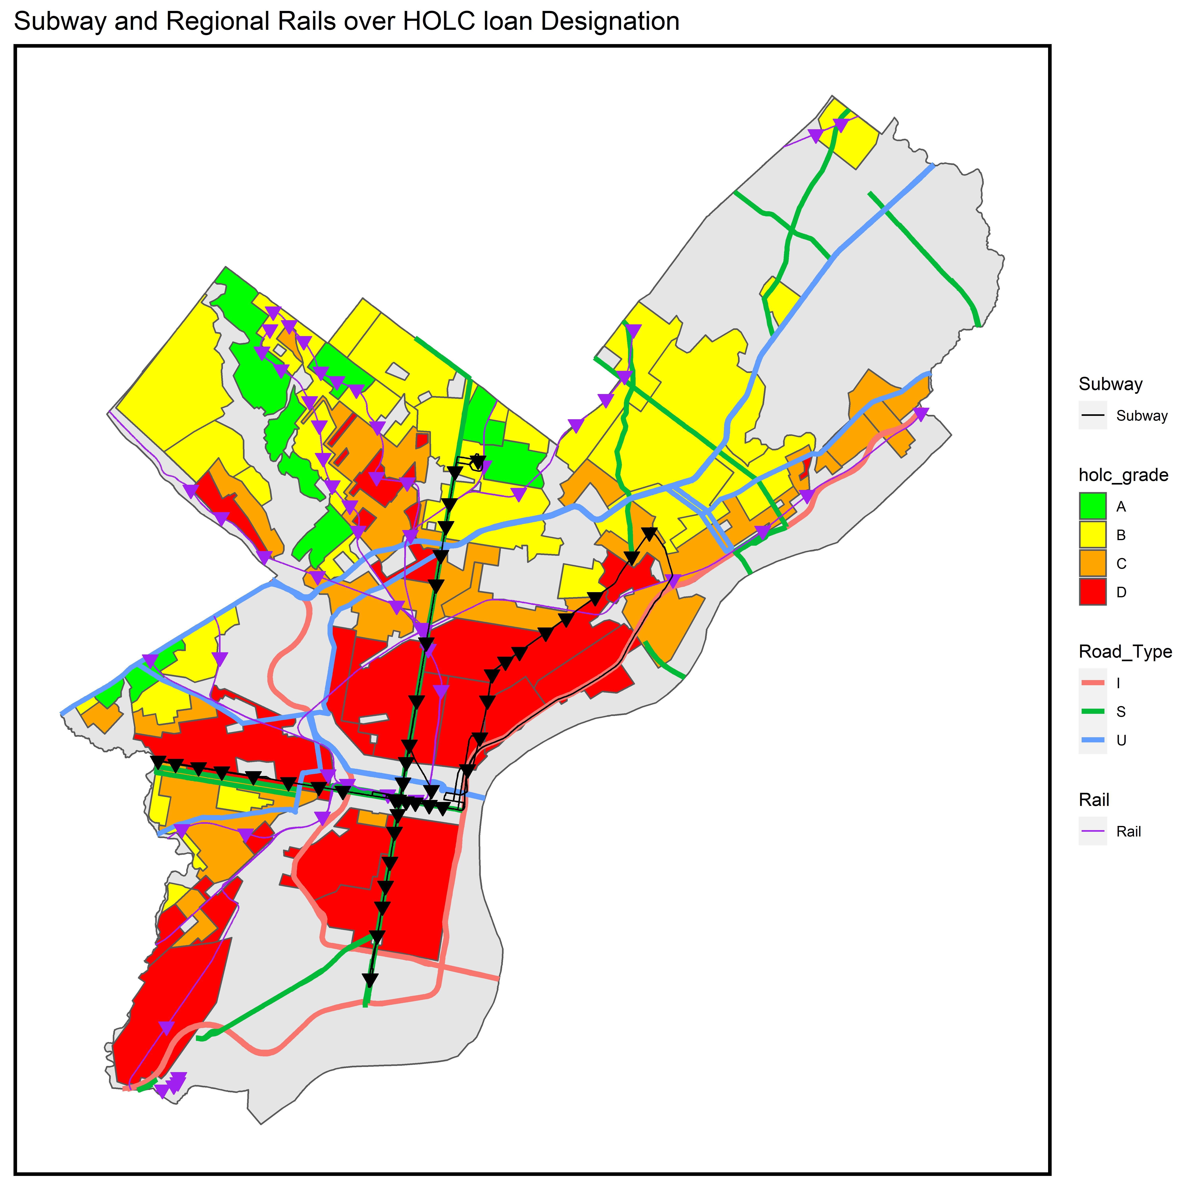
Home Owners Loan Corporation
Are Asian Americans Clustered?

Slide 23
Findings and Conclusions
Asian Americans in Philadelphia immigrate into different locations in Philadelphia
This is observed through LISA, statistics
There is some overlap between different Asian immigrant populations and Home Owner Loan Corporation zoning.
Different parts of Philadelphia have different proximal access to higher education institutions across Philadelphia
Each of these census tracts have differing socioeconomic conditions which may shape access to higher education

Slide 24
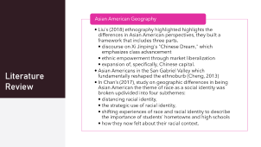


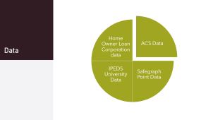
Summary

